Slide 1

Glendale California
Community Assessment

Slide 2
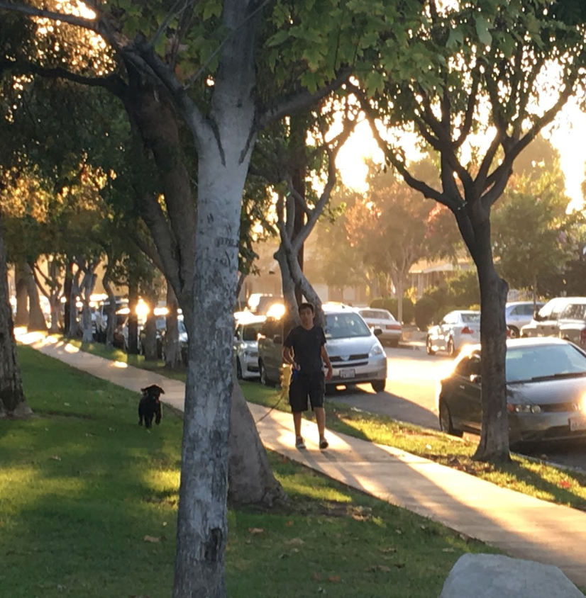
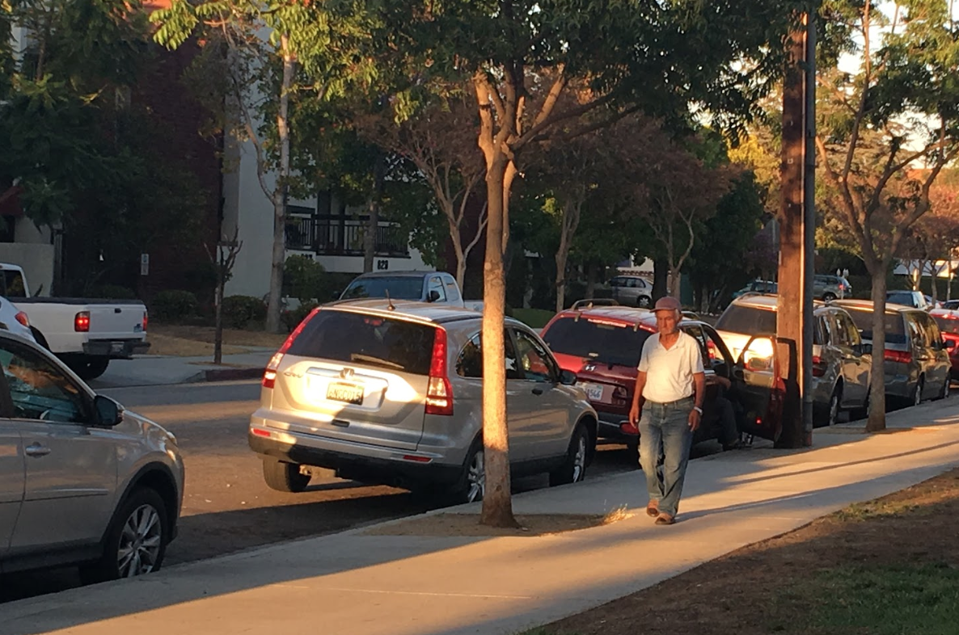
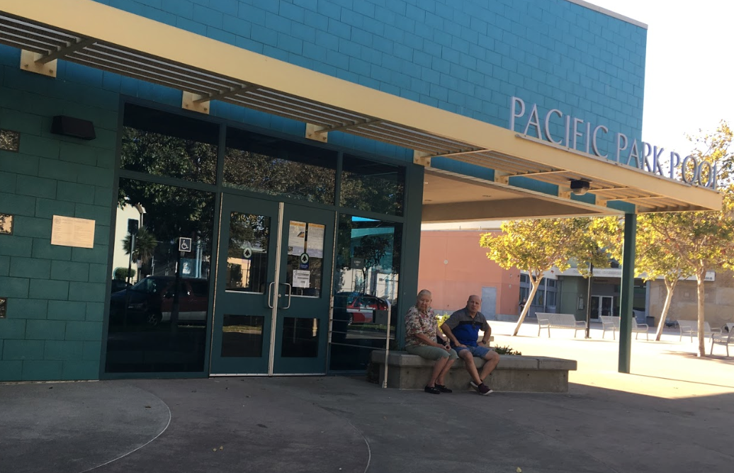
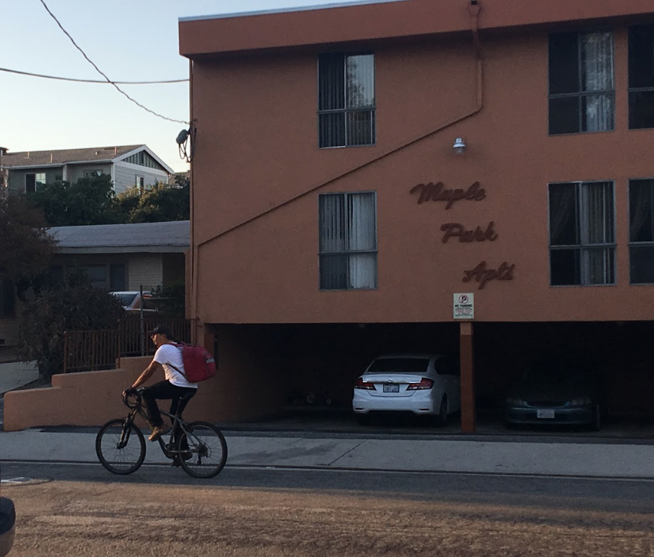
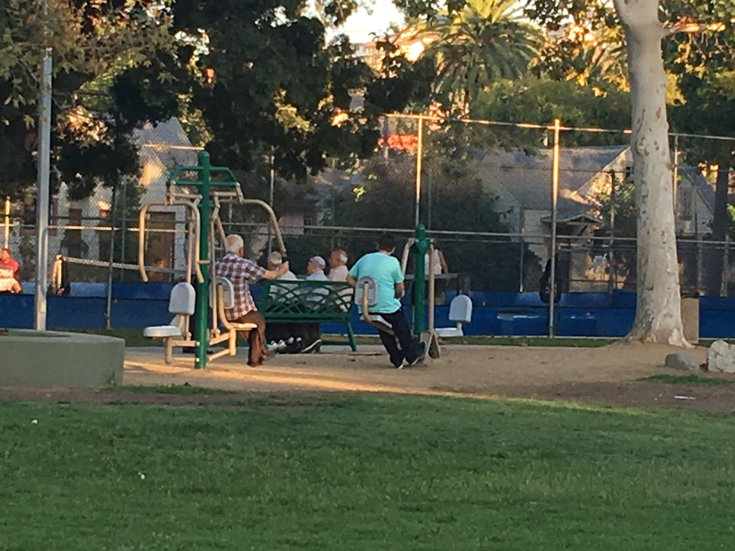
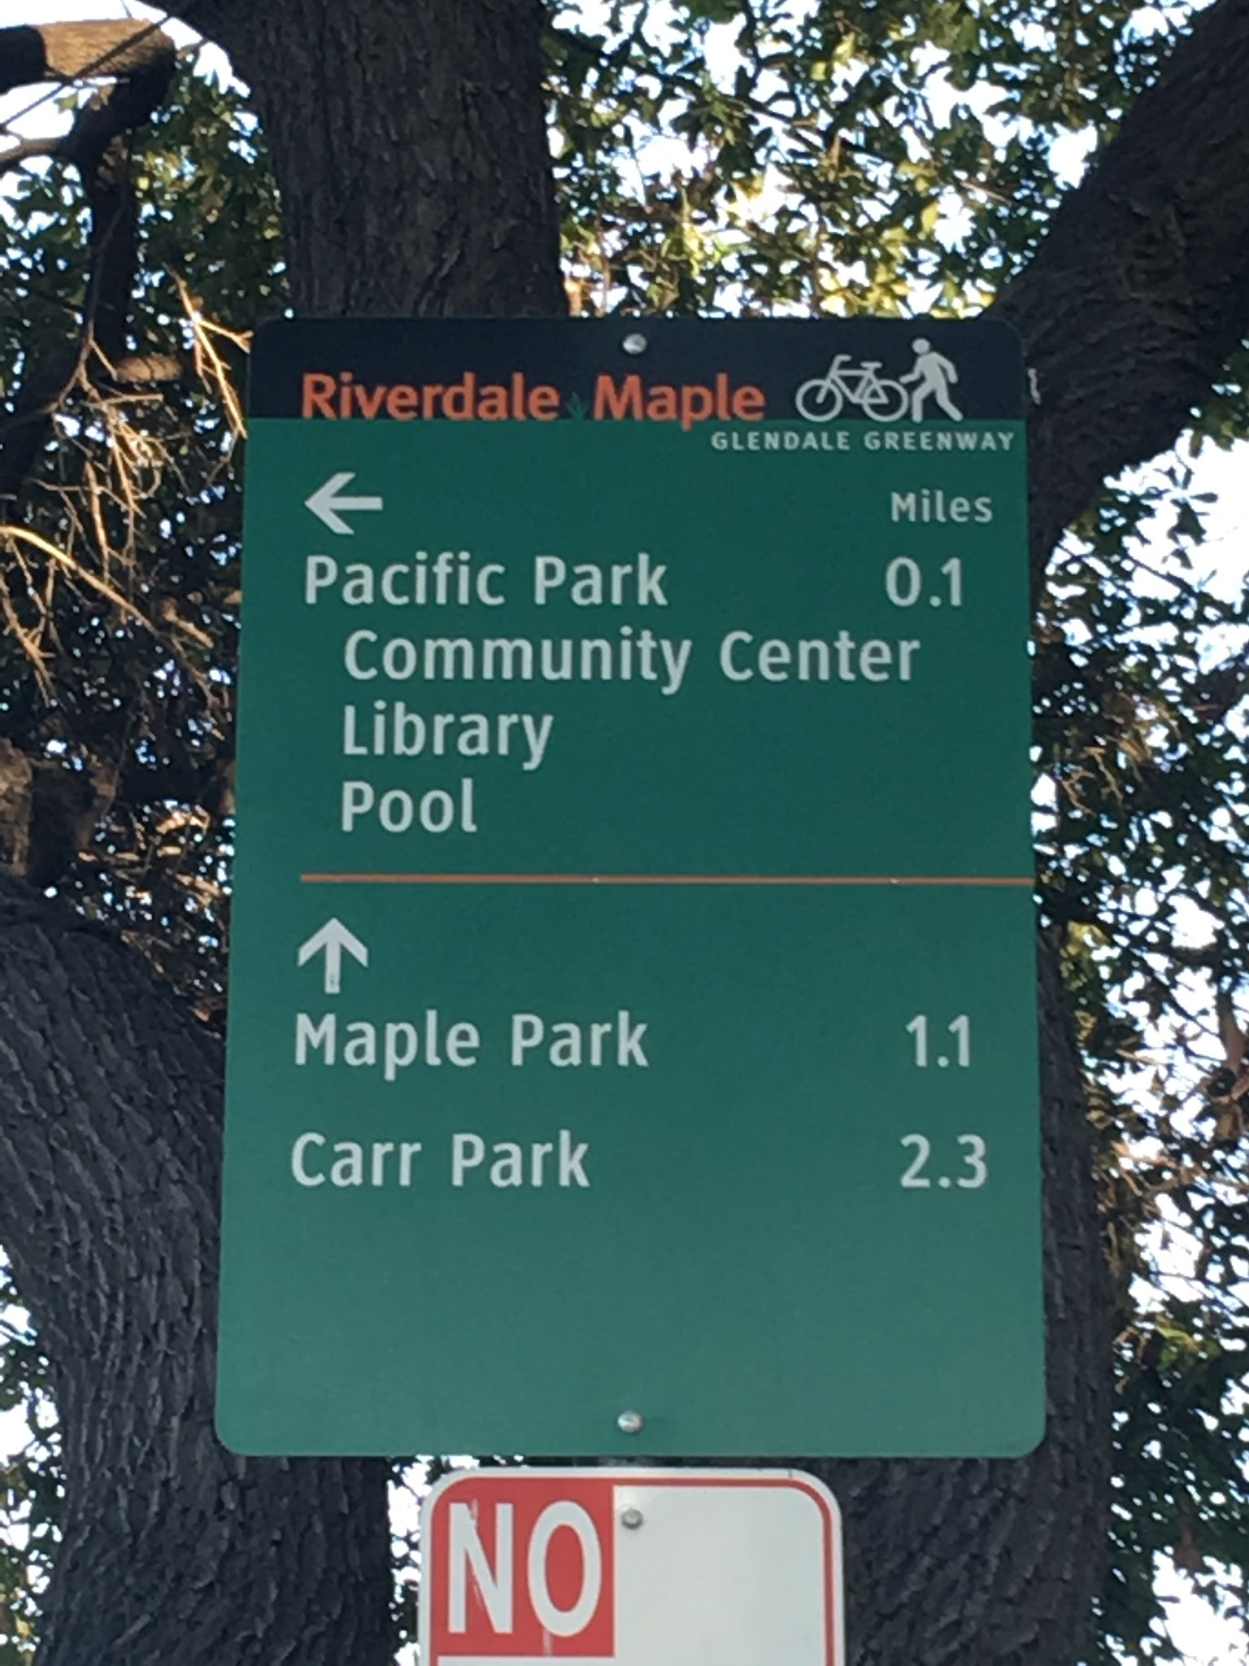
After arrival in the designated community:
Who do you see on the streets: elderly, young males, children & women?
What would it be like to live in the community?
. Do you think people rent or own the housing? RENT

Slide 3
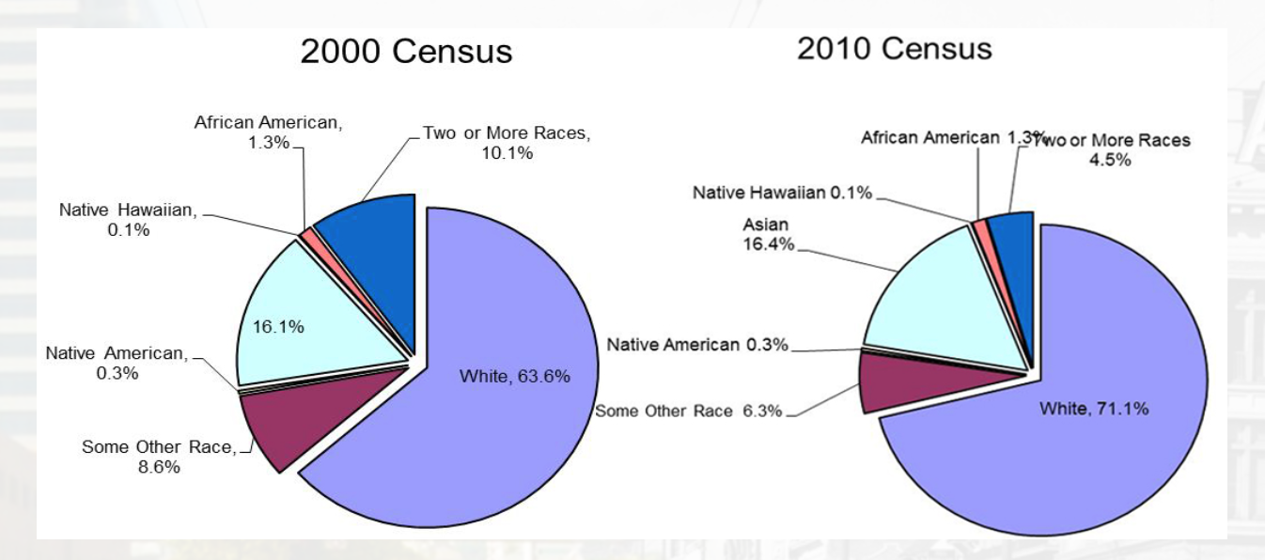
Minority Culture
(Census Information - Racial & Ethnic Characteristics,n.d)

Slide 4
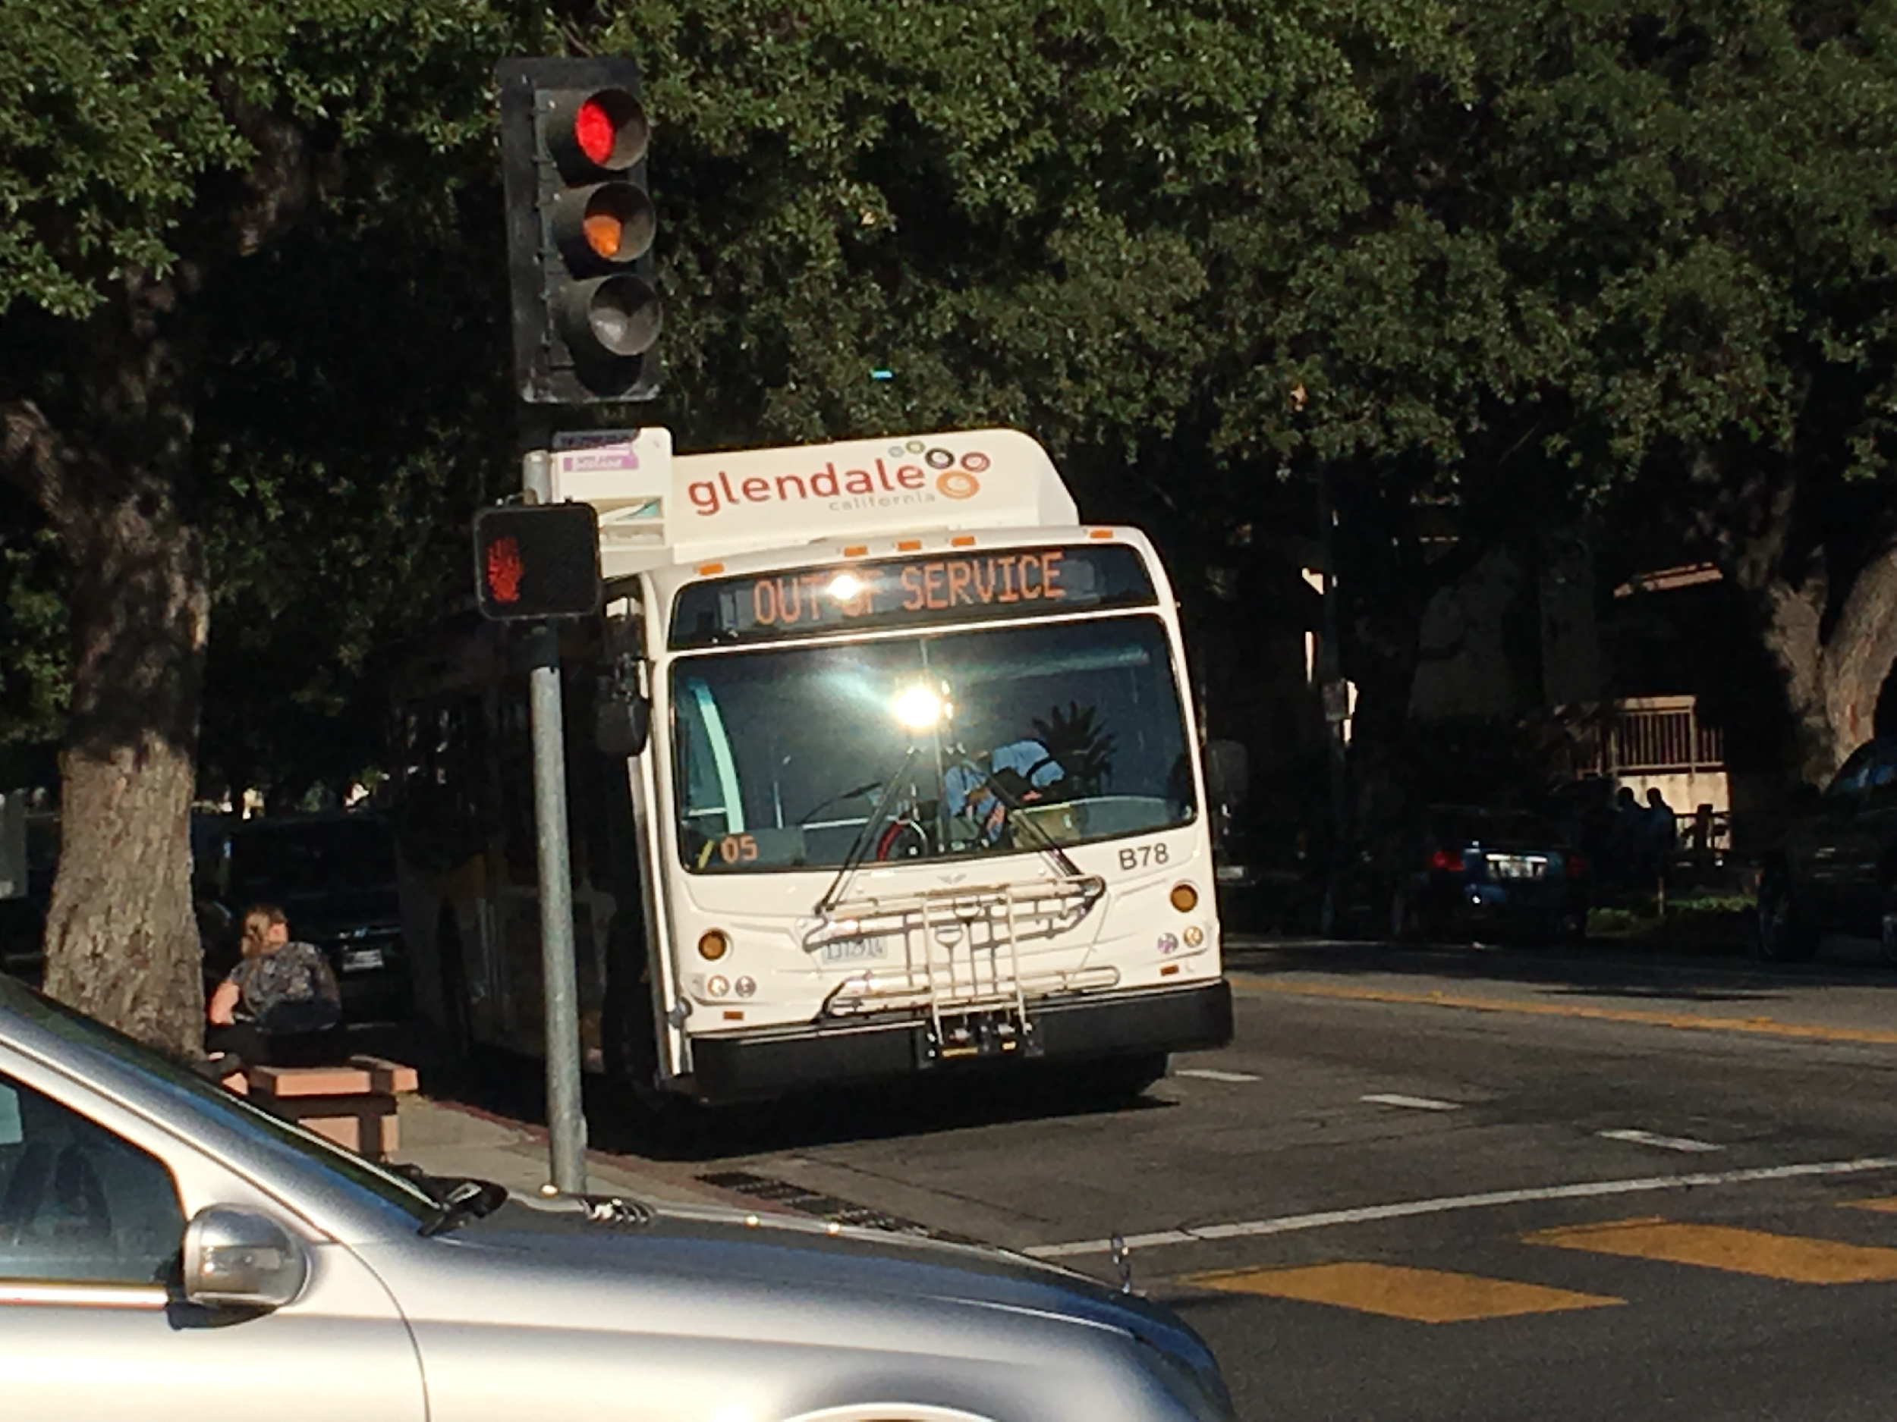
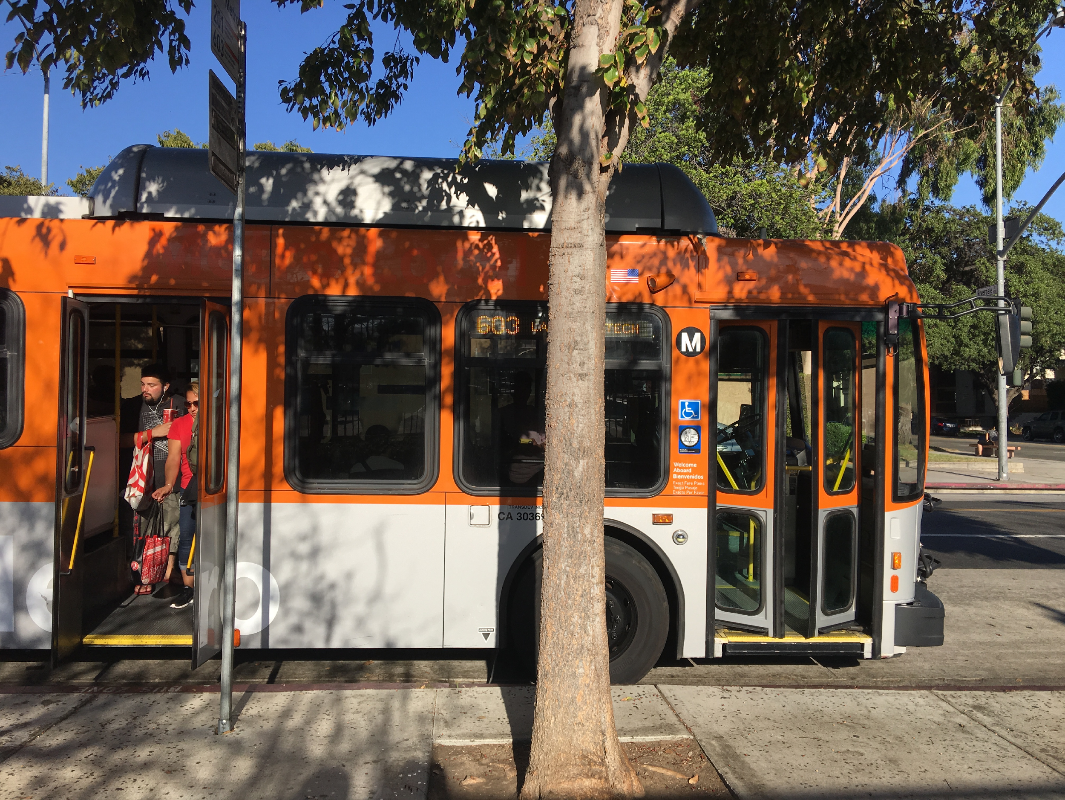
Public Transportation
Glendale Beeline : nine fixed routes / community circulator system
Dial-A-Ride : curb to curb transportation service for 65+ / disabled
Larry Zarian Transportation Center : Amtrak, Metrolink, Greyhound, Metro
(Public Transportation. Glendale California Mobile,n.d)

Slide 5
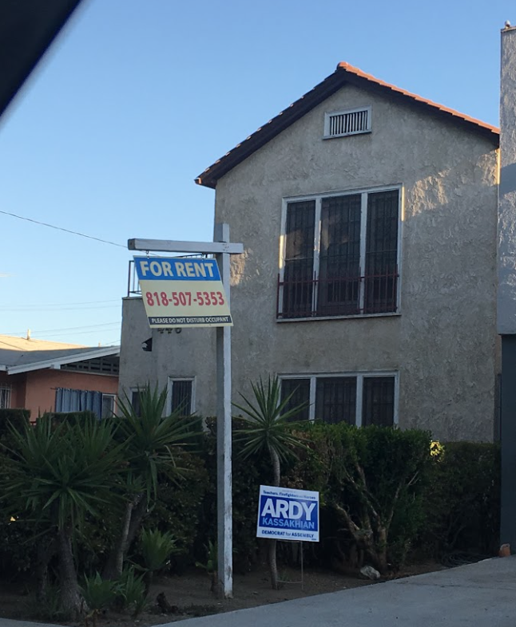
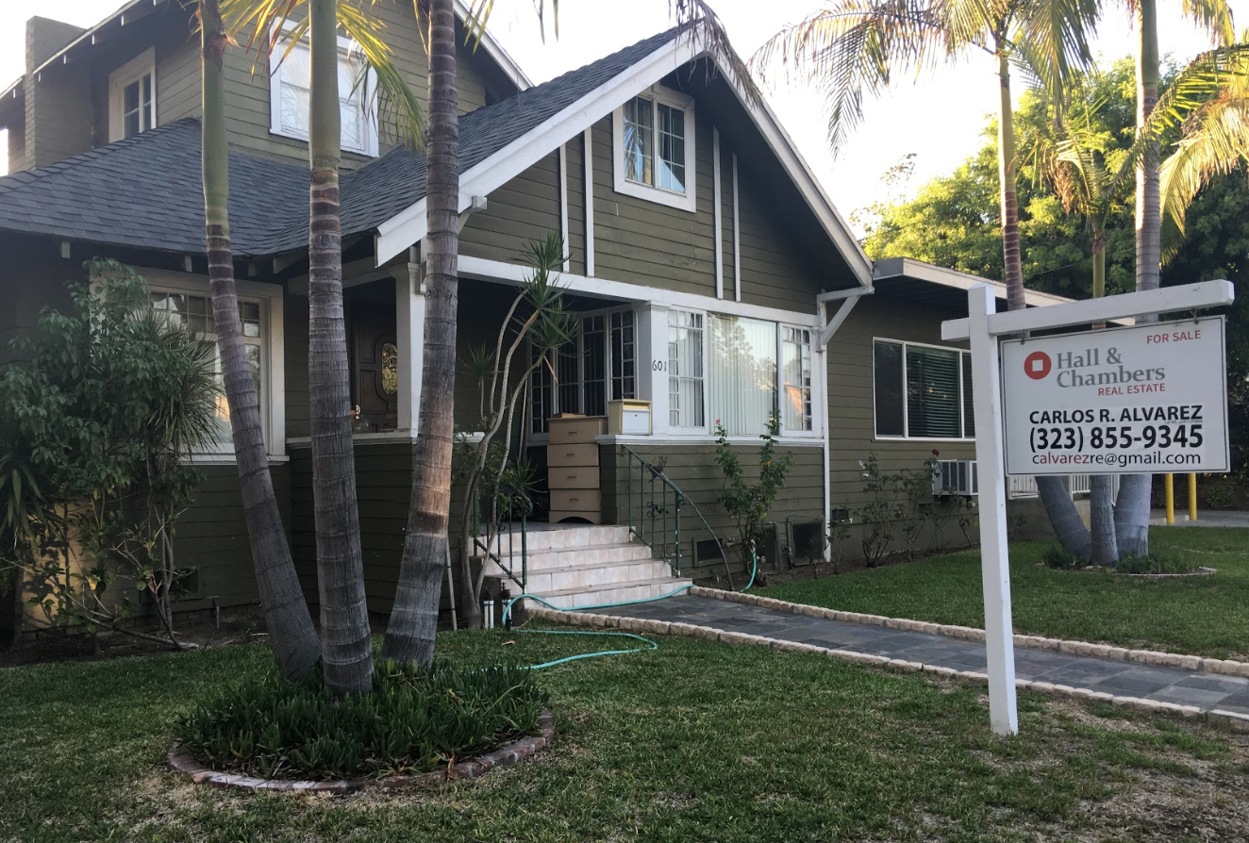
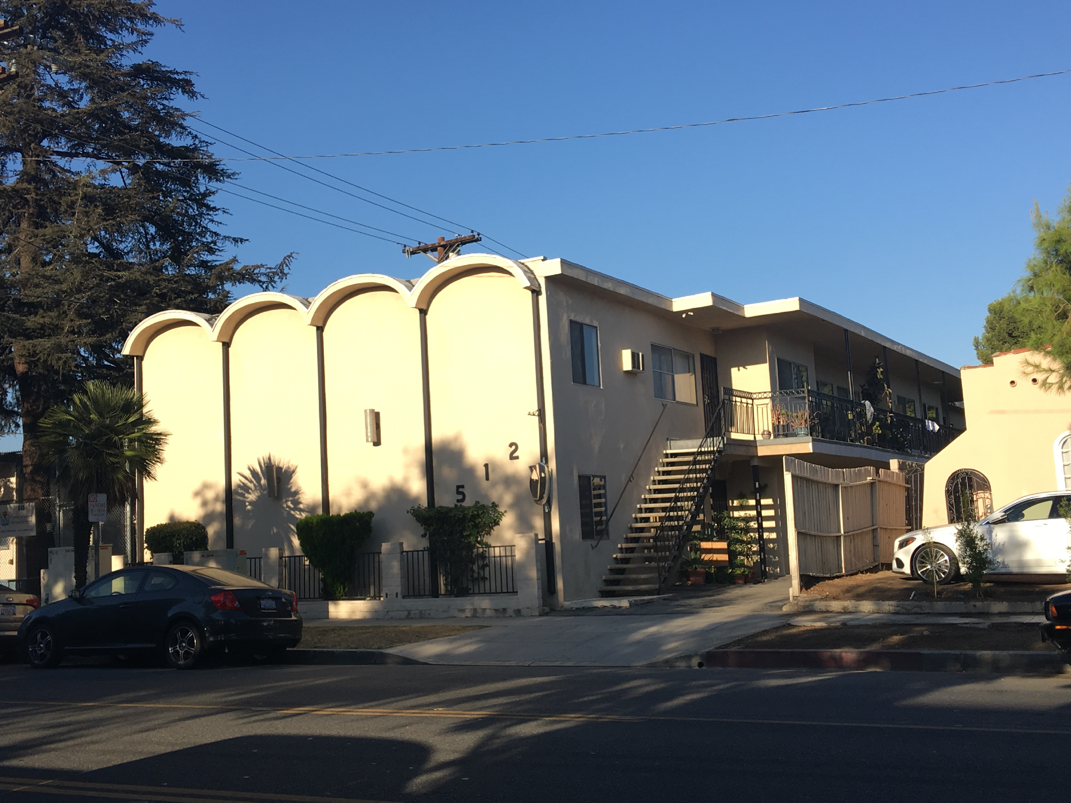
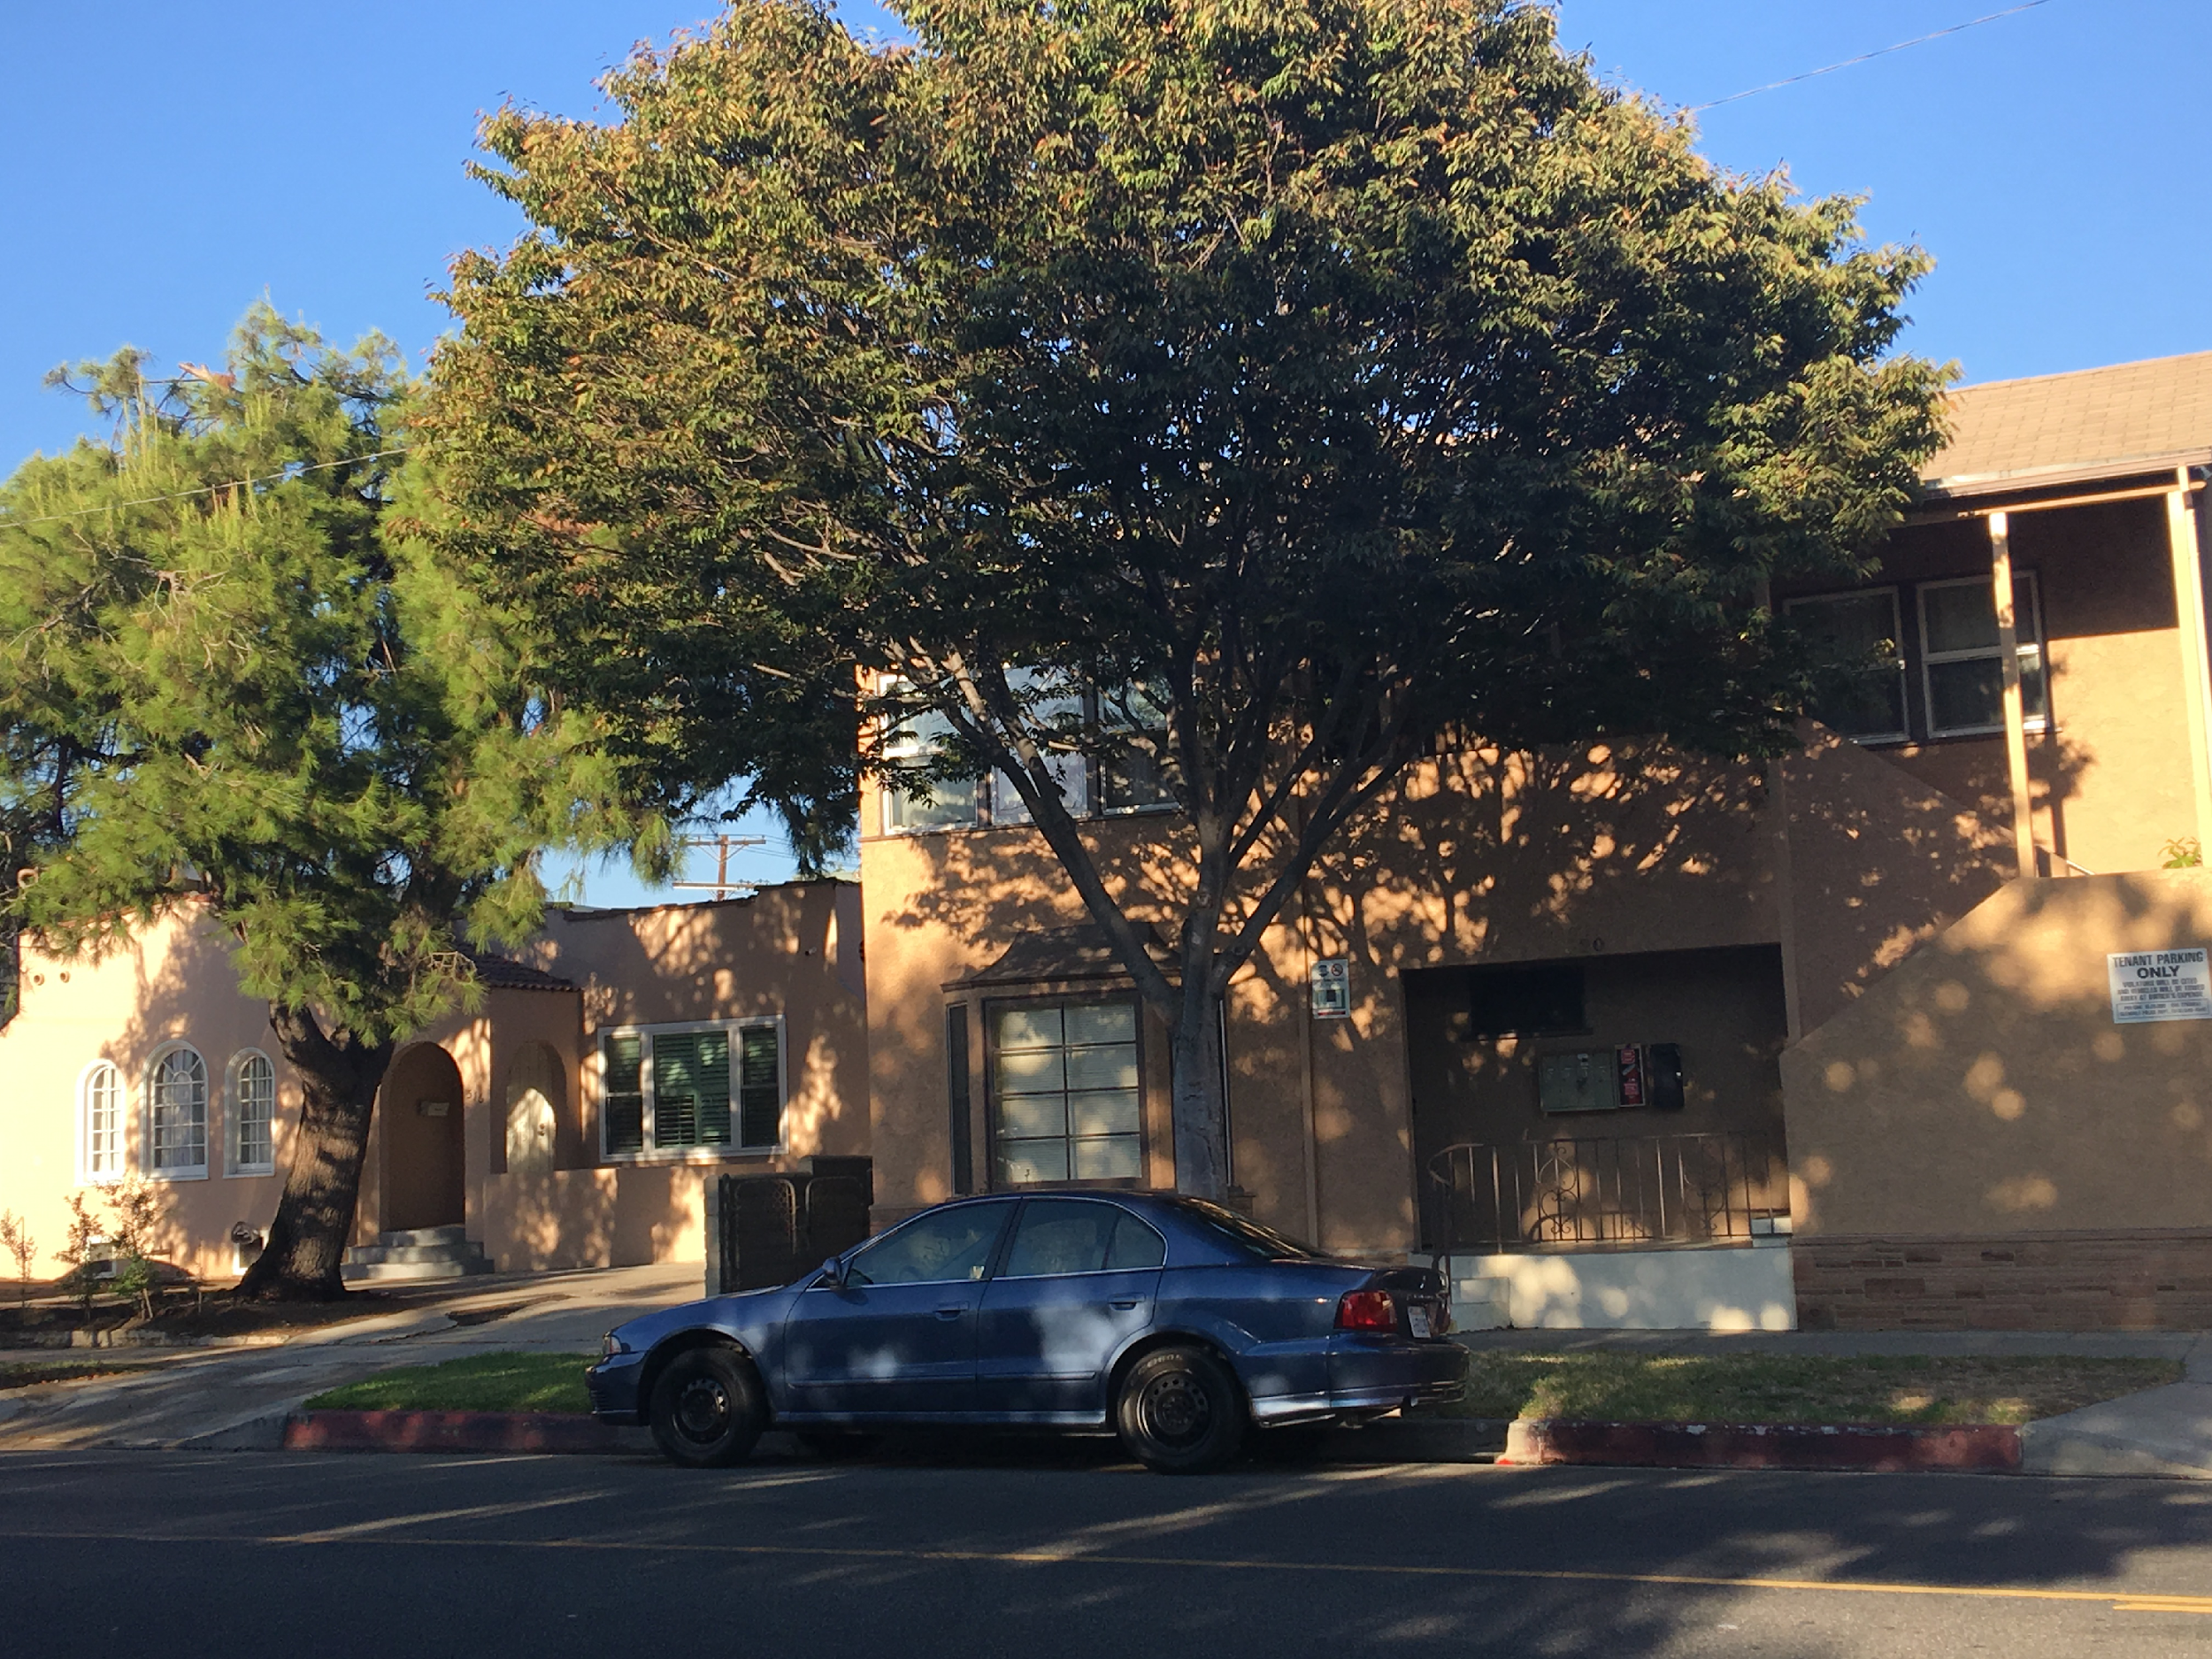
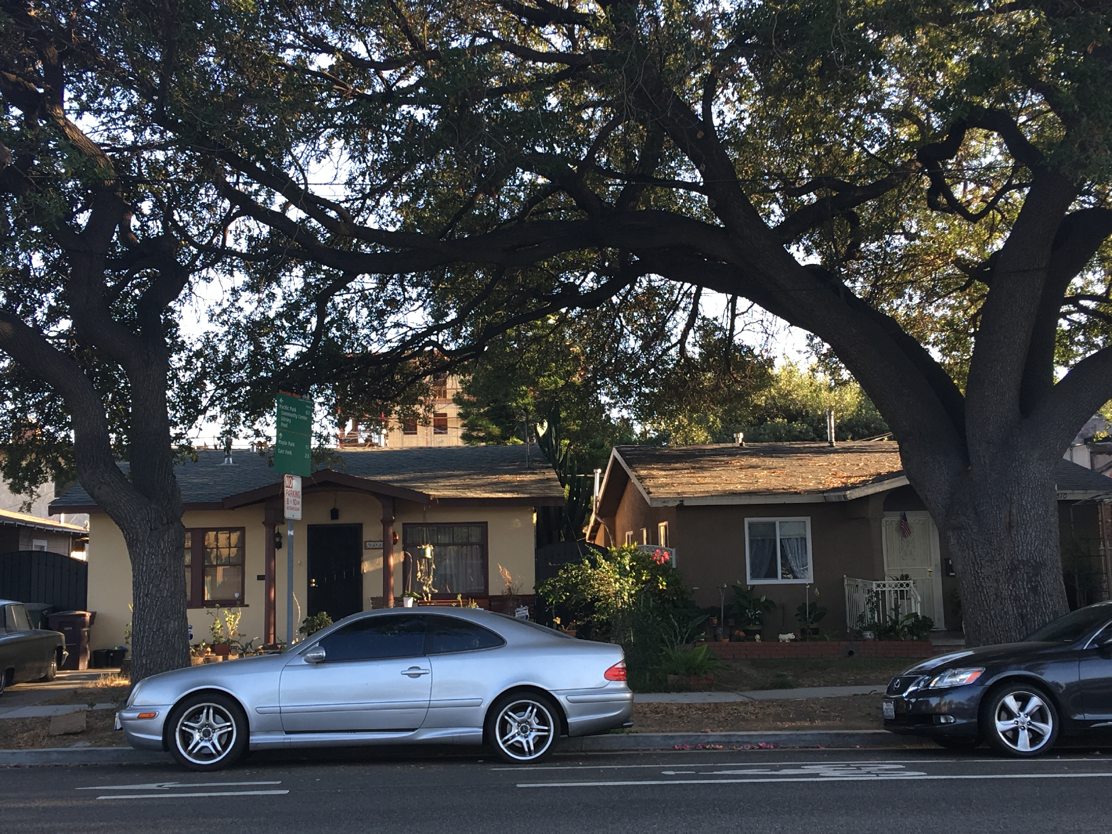
Housing
Rent (August 2016)
All beds $2,522
1 bedroom- $2,255
2 bedroom-$2,947
NO RENT STABILIZATION/
CONTROL
Home Prices & Values
Median house value – $735,800
Price Per Sqft- $446
Median Rent Per Month - $2995
(Rent trend data Glendale, California,n.d)

Slide 6
Social-economic status
Employment Status Employed – 85,113
Unemployed – 6,559
Commuting to work Car, truck, or van – 61,751
Public transportation (including taxicab) – 3,675
Walked – 2,698
Occupation Management, professional – 34,475
Service occupations – 10,463
Sales & office occupations – 25,832
Farming, fishing, forestry occupations – 118
Construction, extraction, maintenance – 5,459
Production, transportation – 8,766
(Economic Statistics, n.d)

Slide 7
Industries
Agriculture, forestry, fishing and hunting - 143
Construction – 3,742
Manufacturing – 9,029
Wholesale trade – 3,519
Retail Trade – 9,734
Transportation and warehousing, and utilities – 3,269
Finance, insurance, real estate, and rental and leasing – 7,881
Professional. Scientific, management, administrative, waste – 10,243
Educational, health and social services – 16, 924
Arts, entertainment, recreation, food service – 6,454
Public administration – 2,855
(Economic Statistics, n.d)

Slide 8
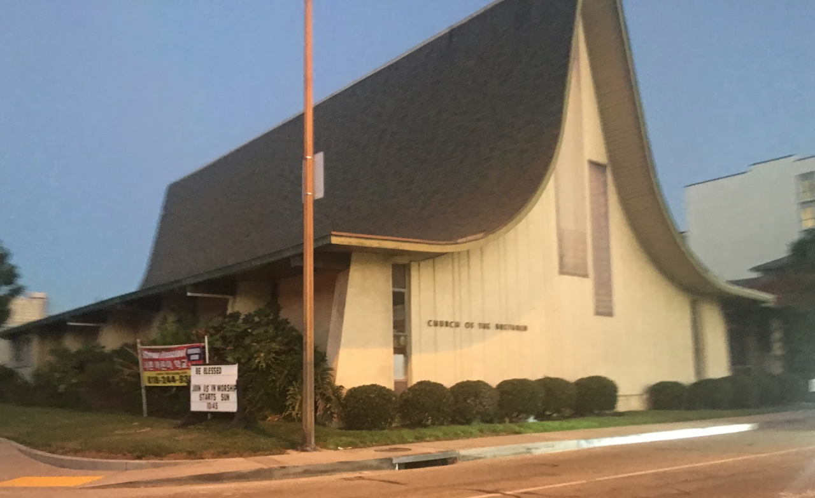
Glendale Churches by Category
Baptist
Catholic
Christian Episcopal
Evangelical Hispanic Spanish
Lutheran Methodist
Pentecostal Presbyterian

Slide 9
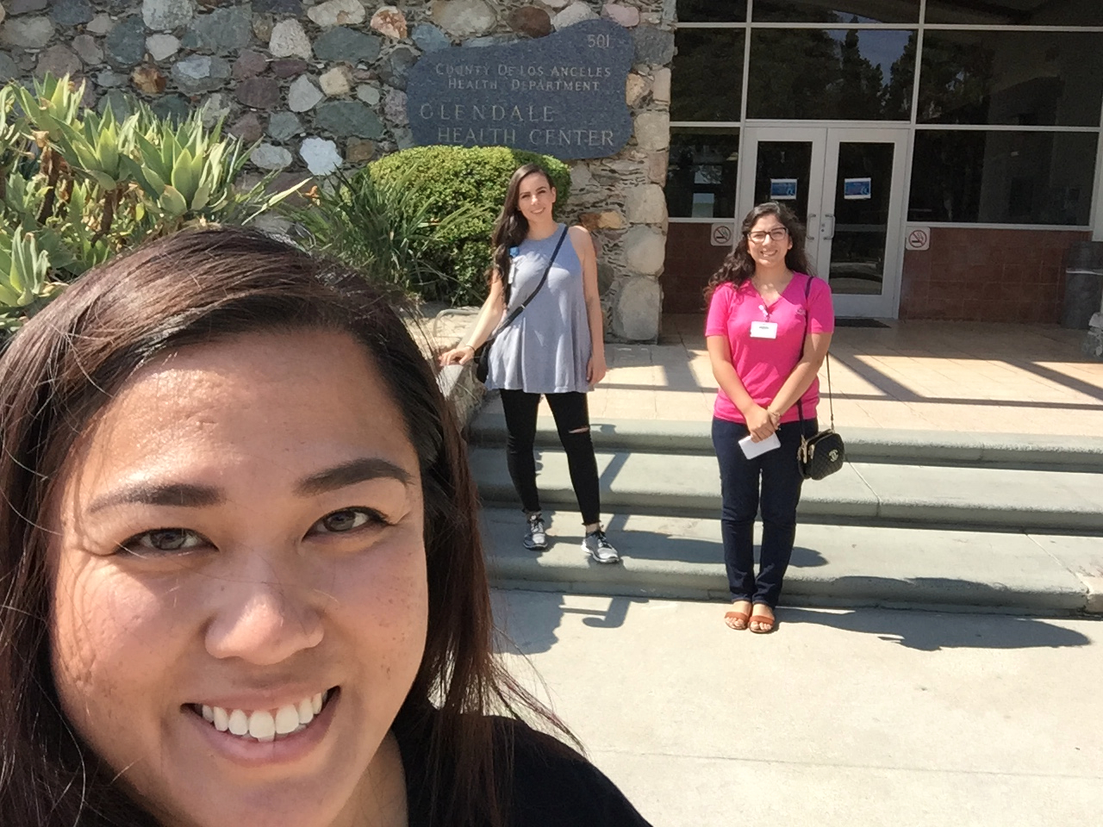
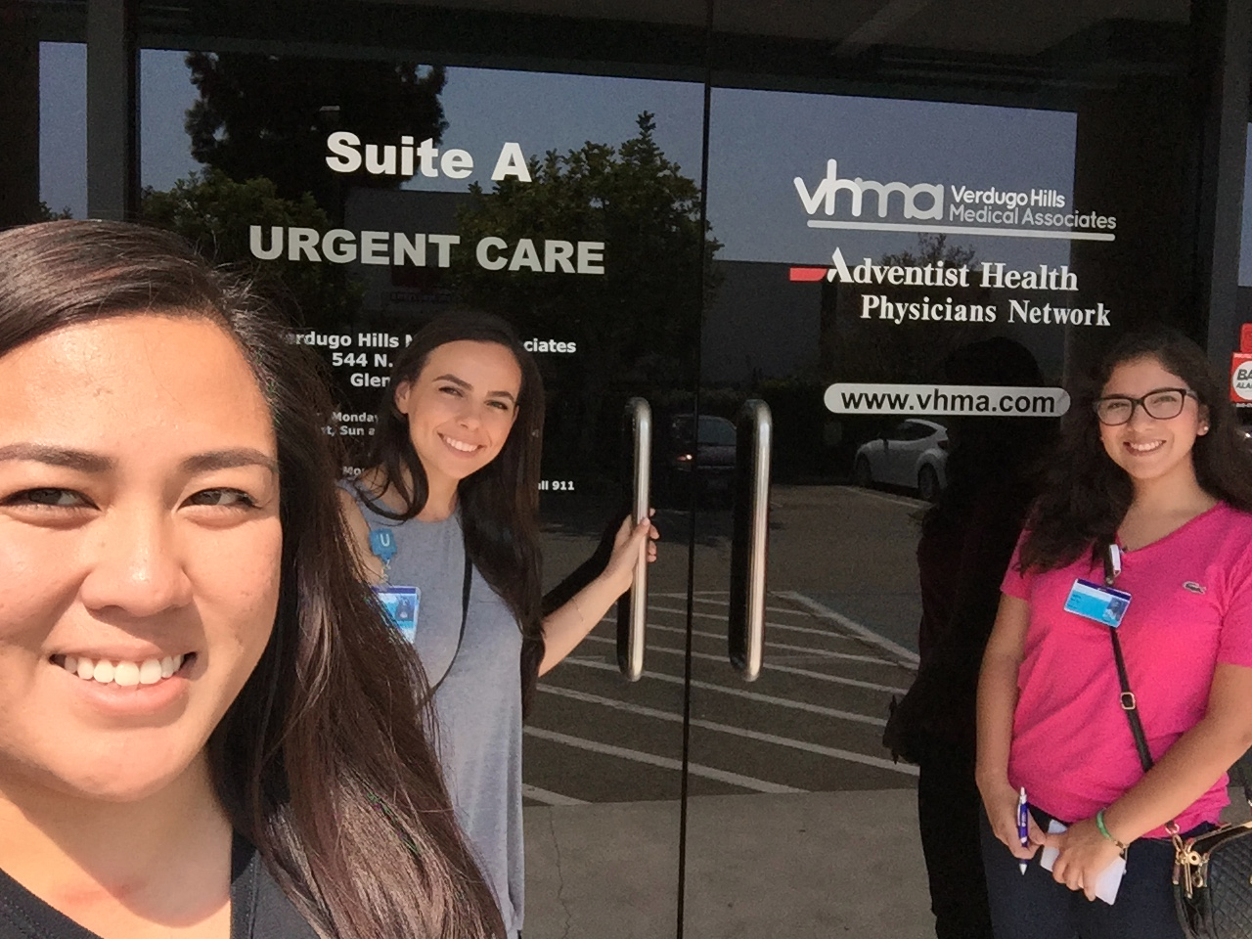
Medical Care Facilities
Glendale Health Center
501 N Glendale Ave, Glendale, CA 91206
Verdugo Hills Medical Associates
544 N Glendale Ave, Glendale, CA 91206

Slide 10
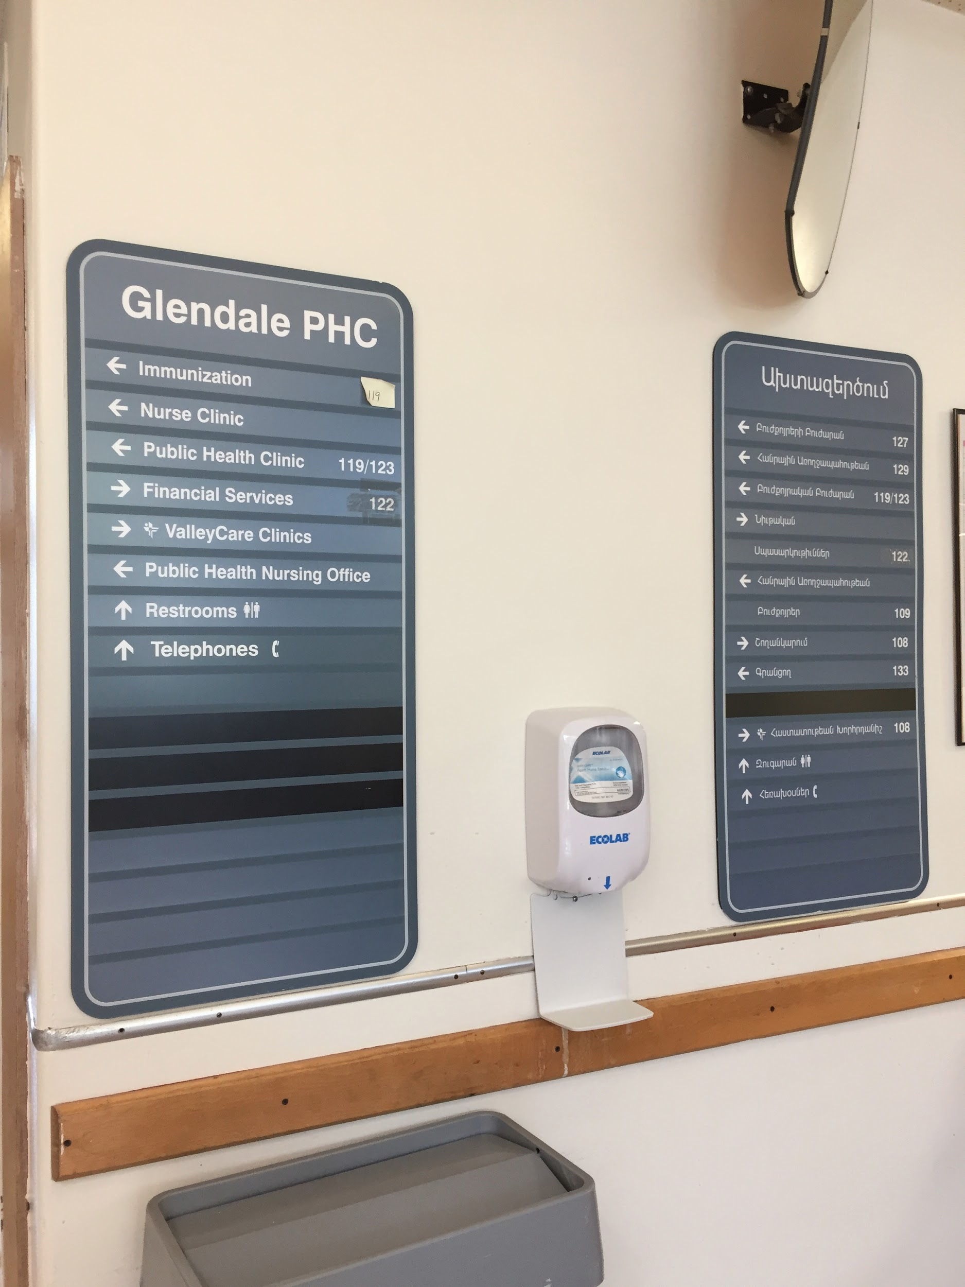
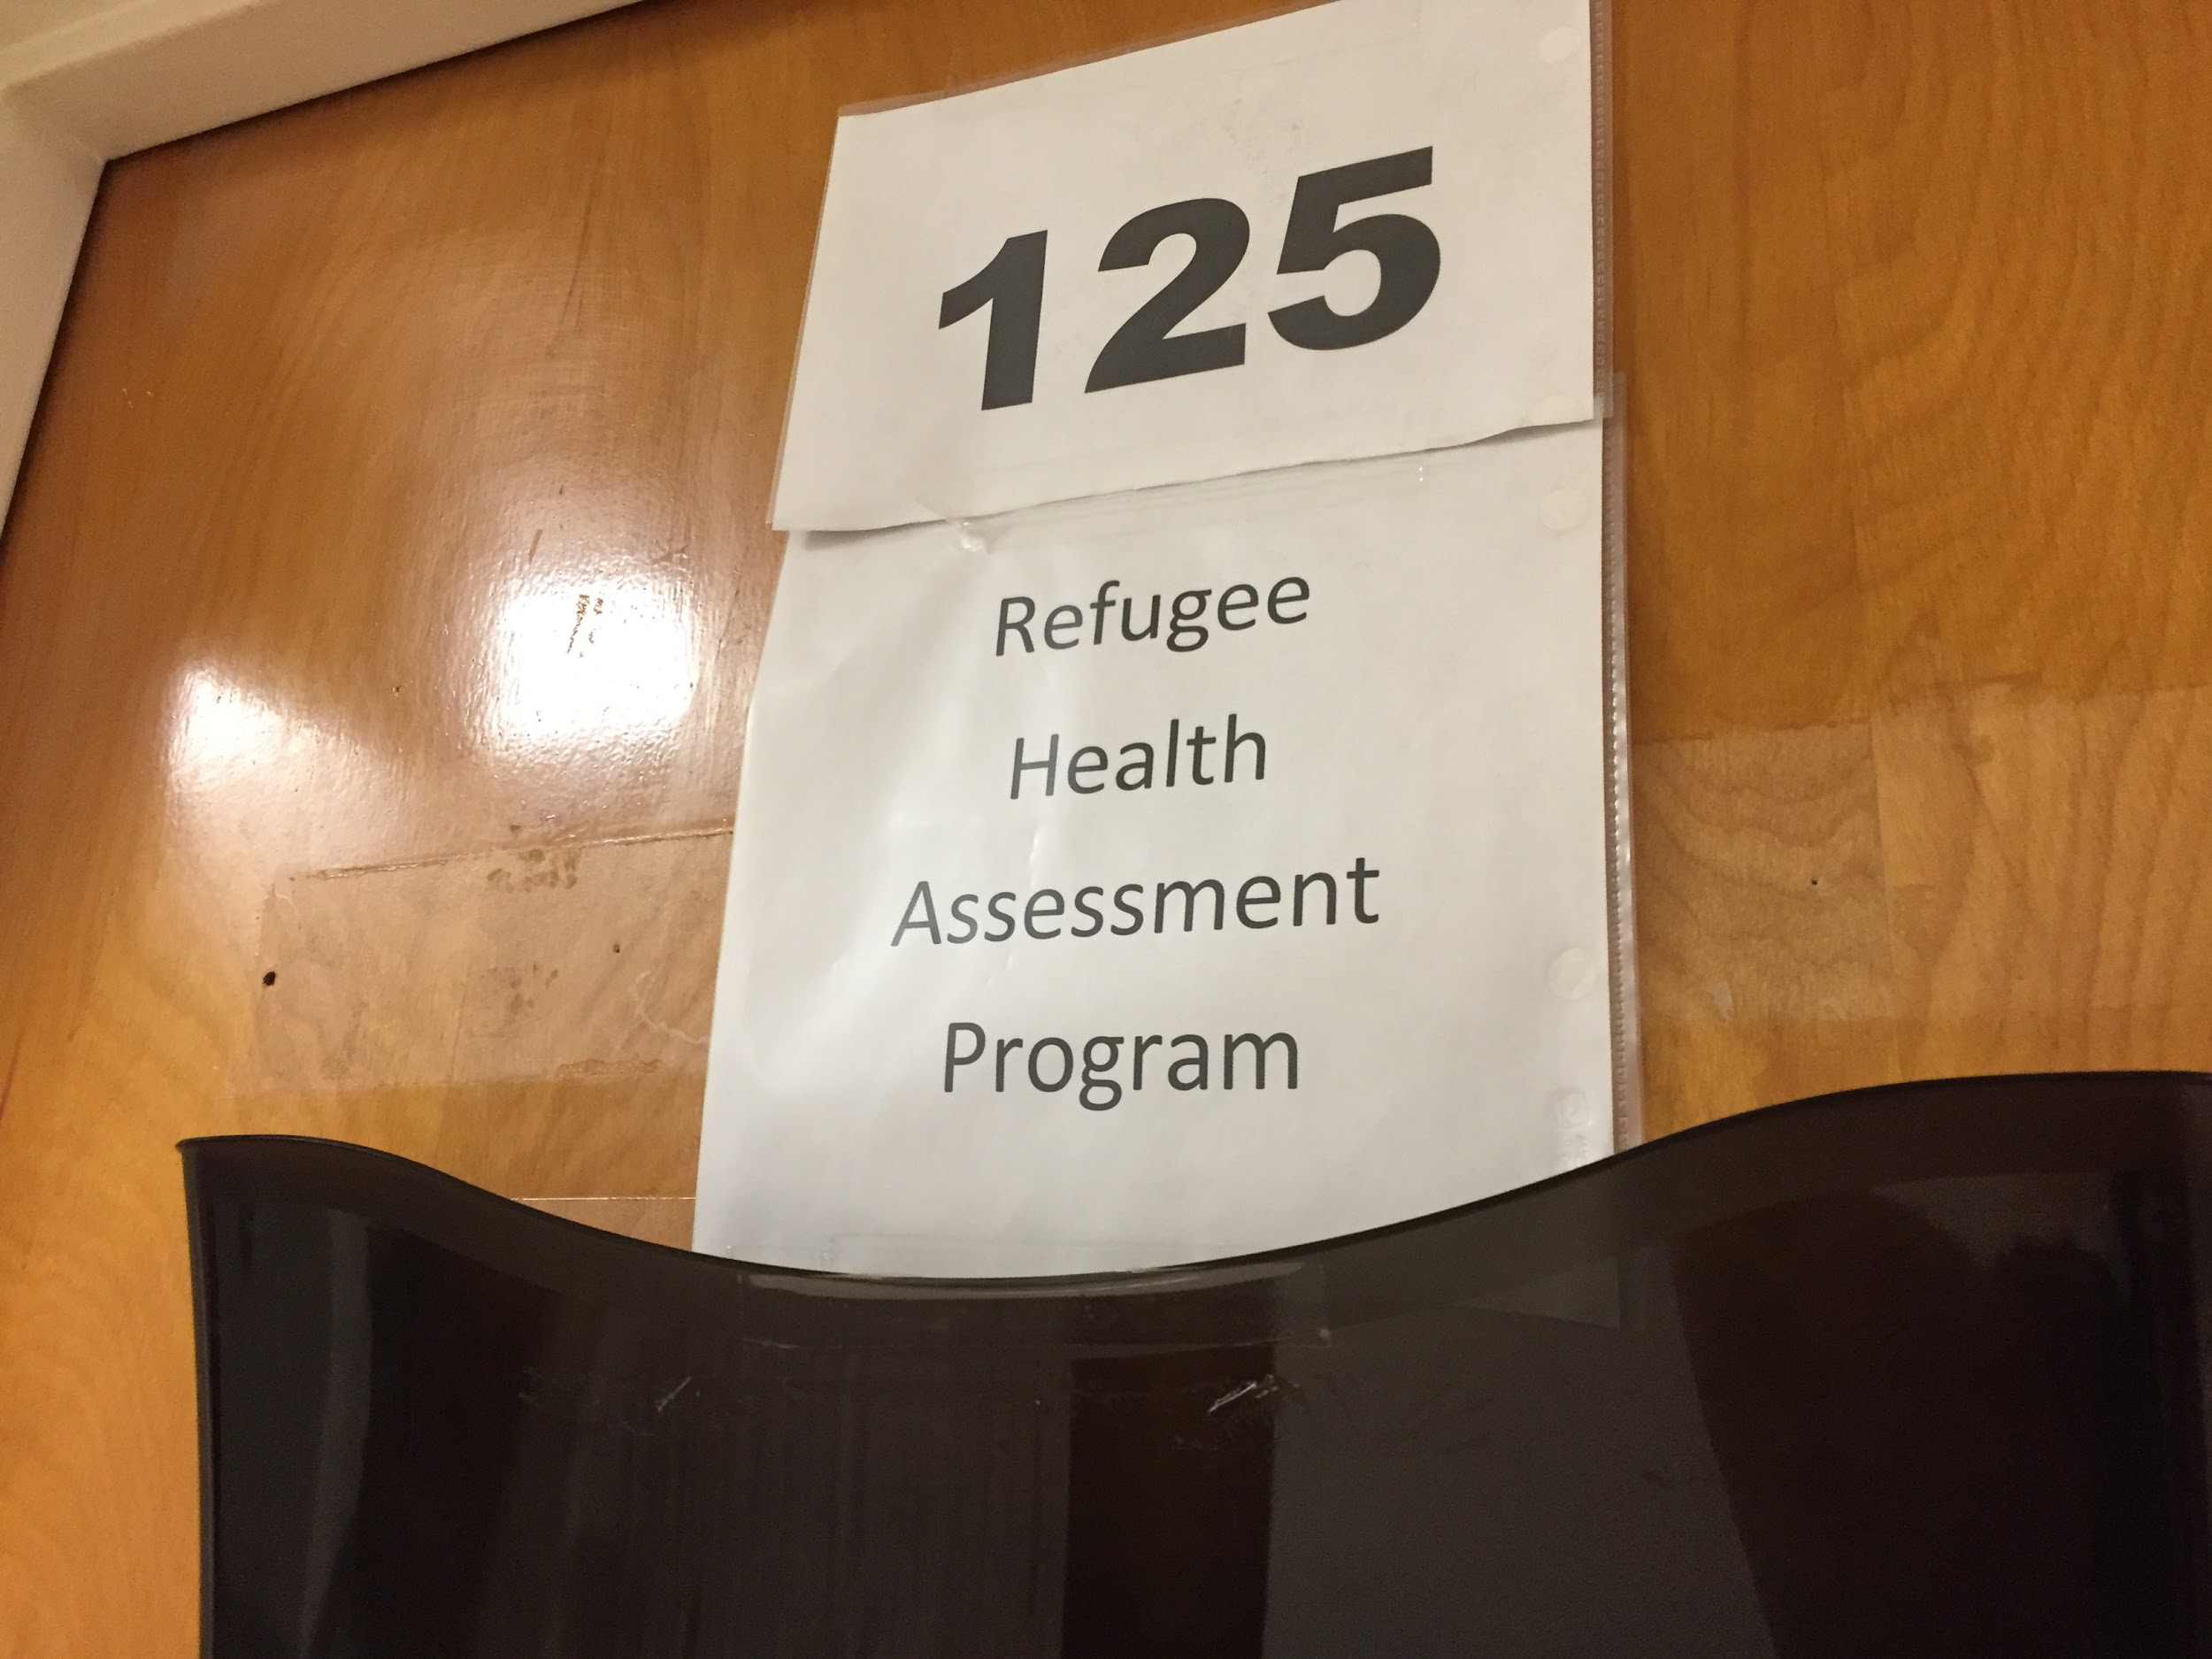
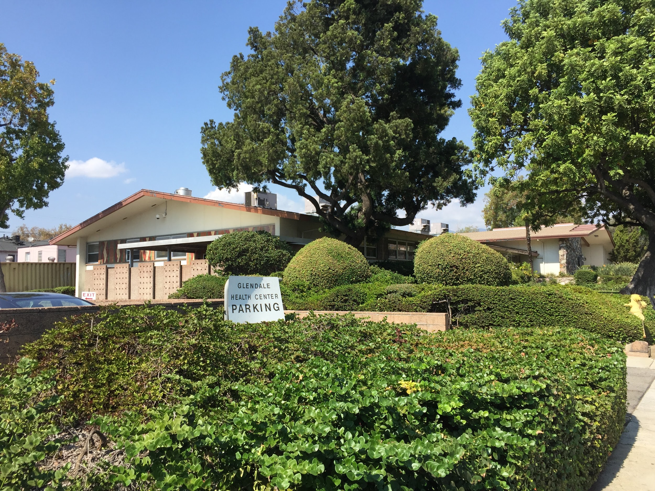
Accessibility:
Glendale Health Center :
Insurance or Cash
Appointment preferred/ walk-ins
Translator (Language line)
Free parking lot area/ disabled parking available
M-F: 7:30AM-4:30PM

Slide 11
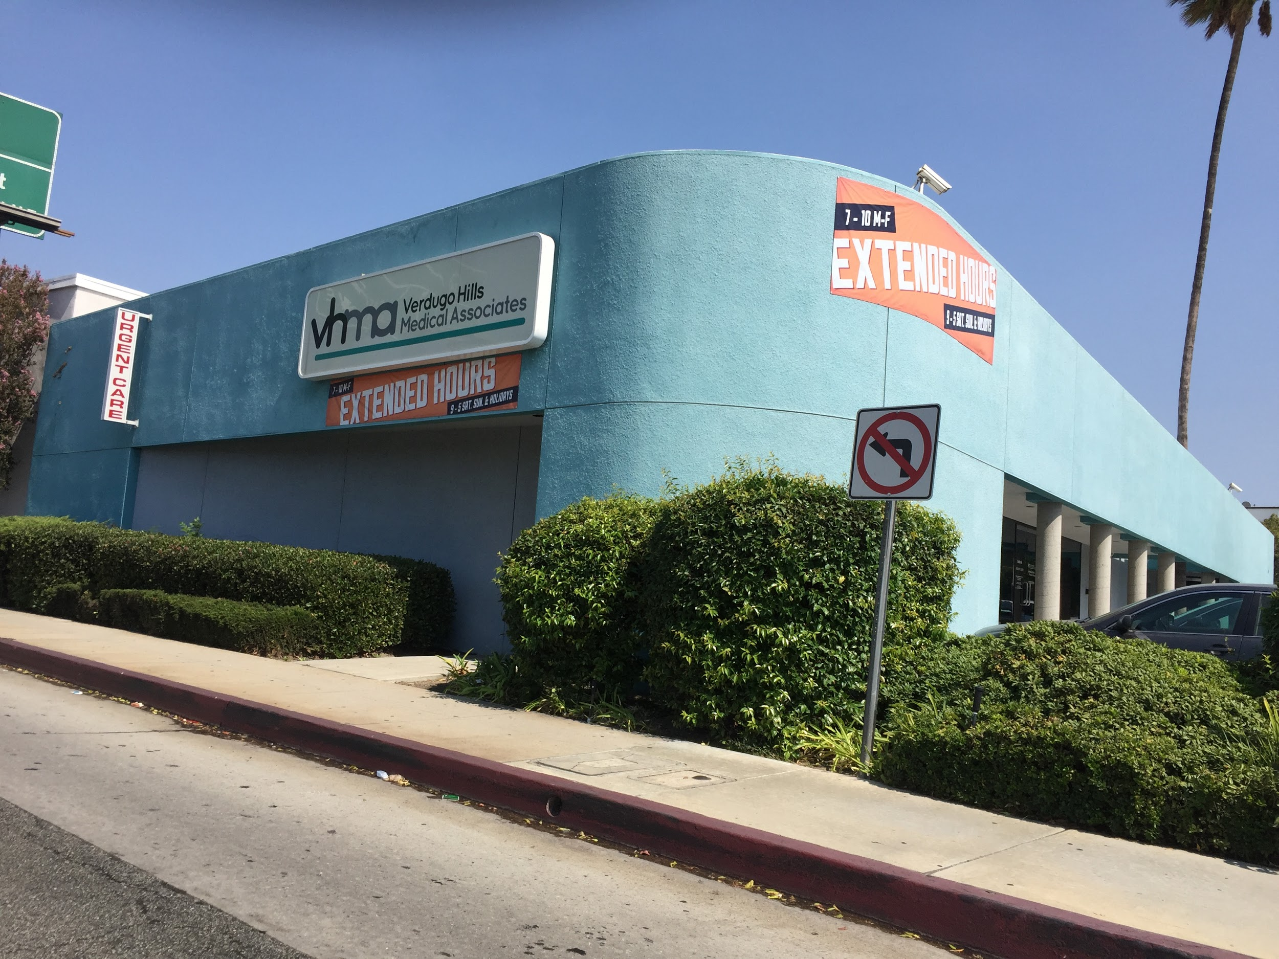
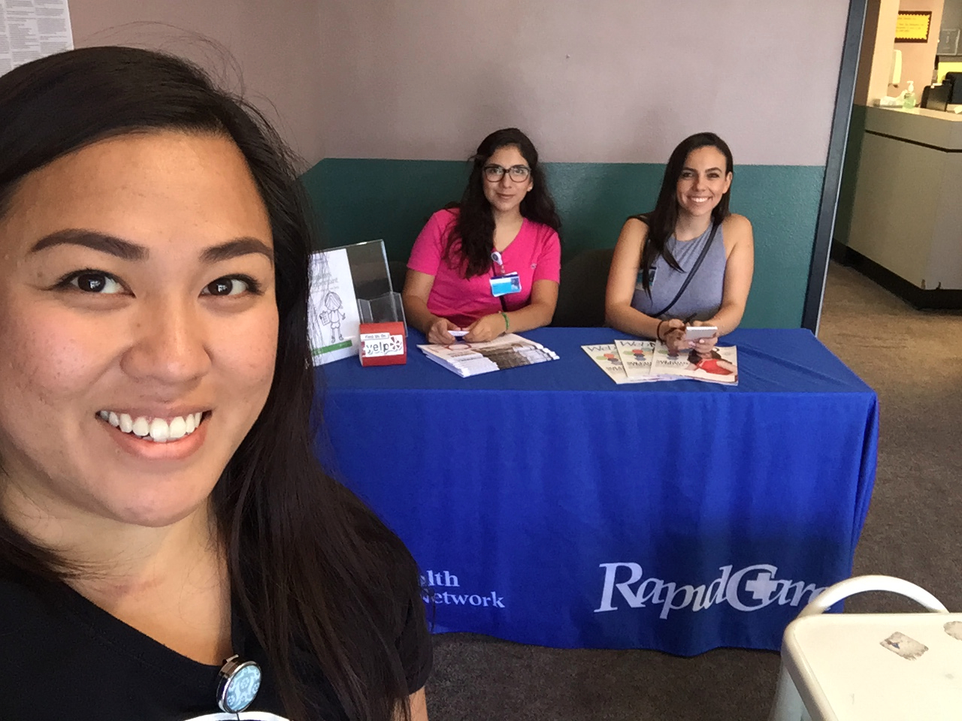
Accessibility:
Verdugo Hills Medical Associates :
Insurances (HMO, Medical, Medicare, Cash)
No Appointment/ Only walk-ins
Free parking lot area/ disabled parking available
M-F:7AM-10PM/ S-S: 9AM-5PM

Slide 12
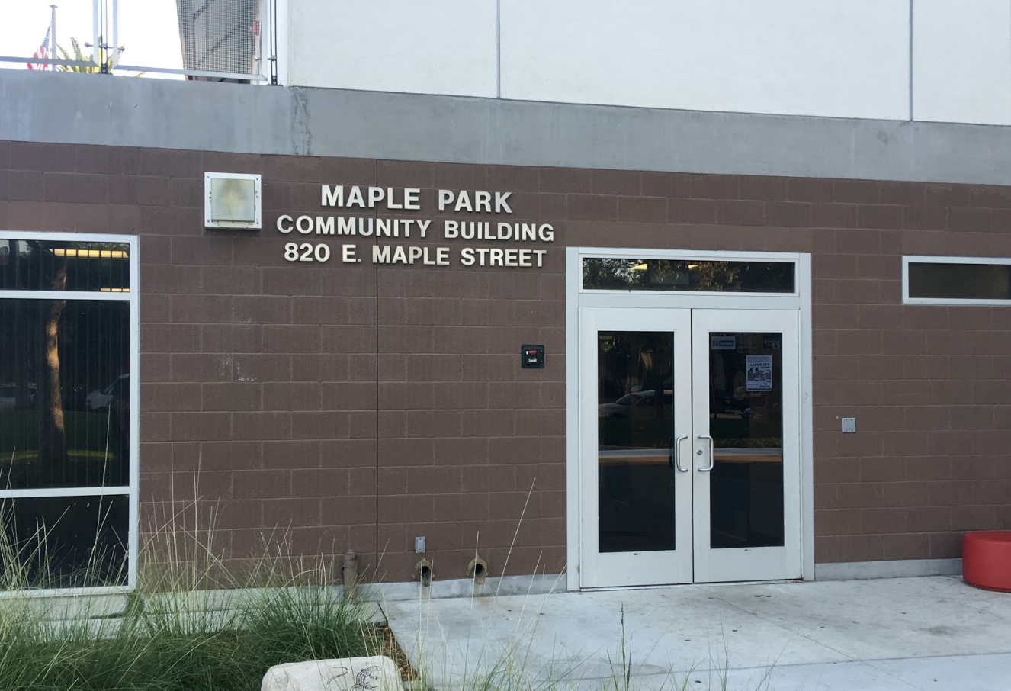
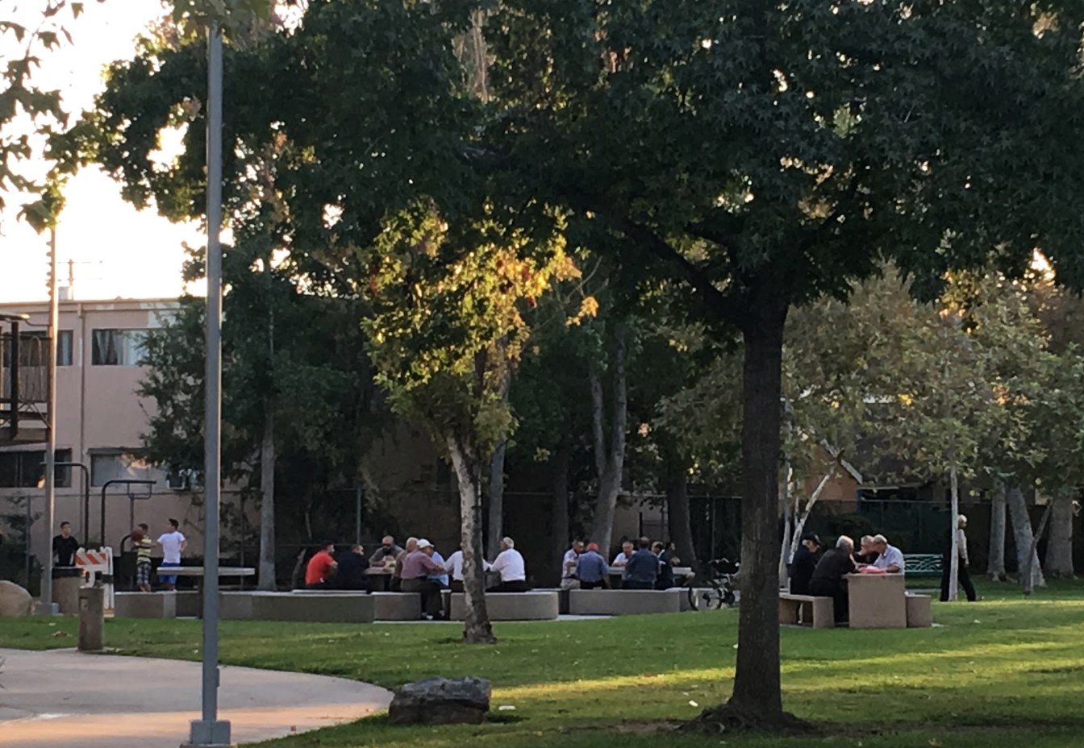
Recreational Facilities
Maple Park Community Building / 820 E. Maple Street
Tennis court
Walking paths & benches
Multi-use fields for sports
Picnic tables
Children's Play Area
Computer Lab
Education facility
Recreational Room
Gym
Outdoor terrace

Slide 13
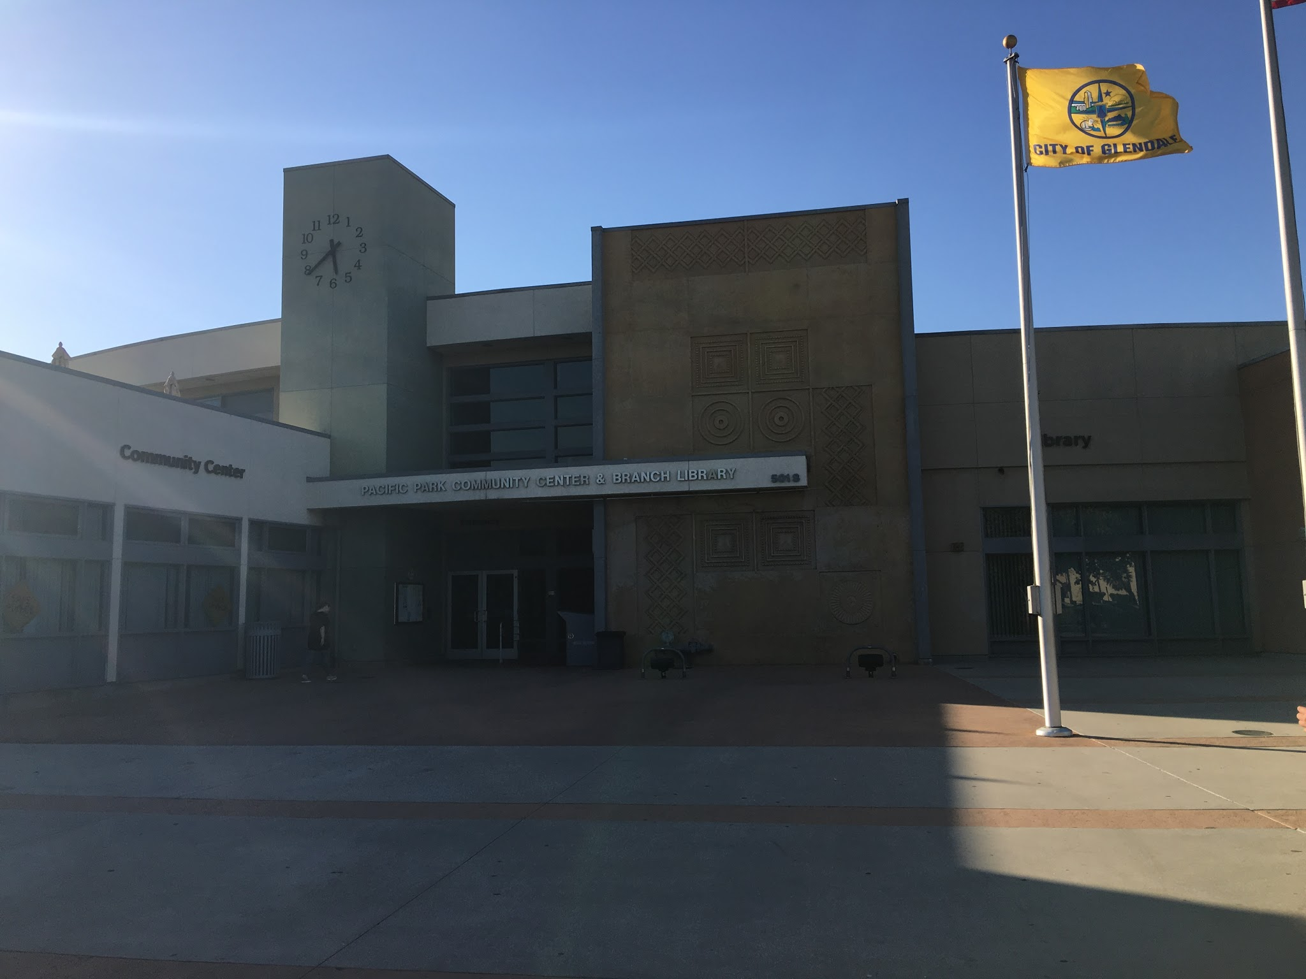
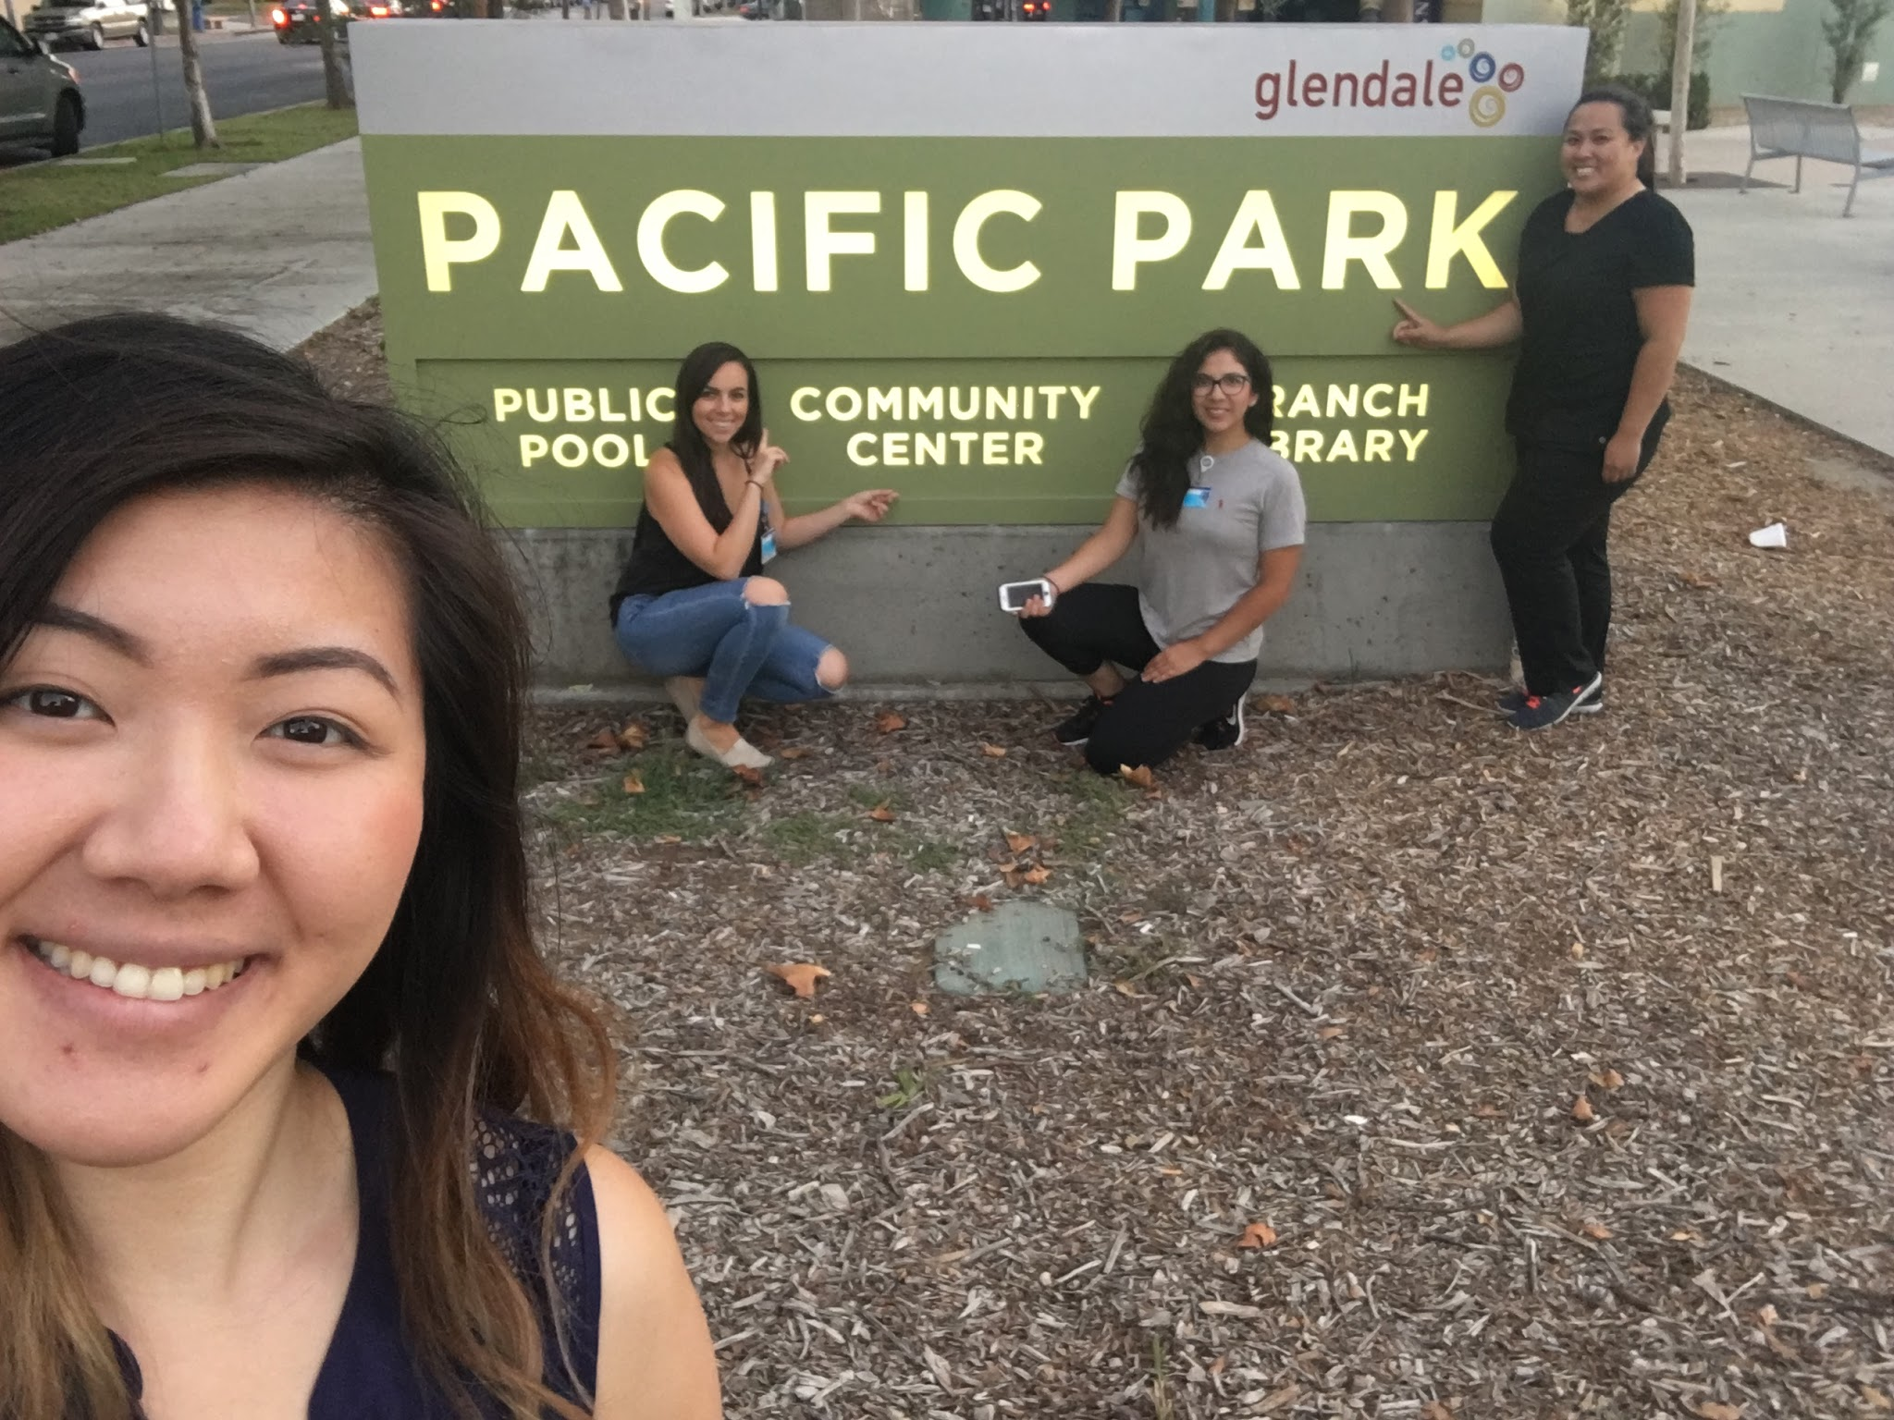
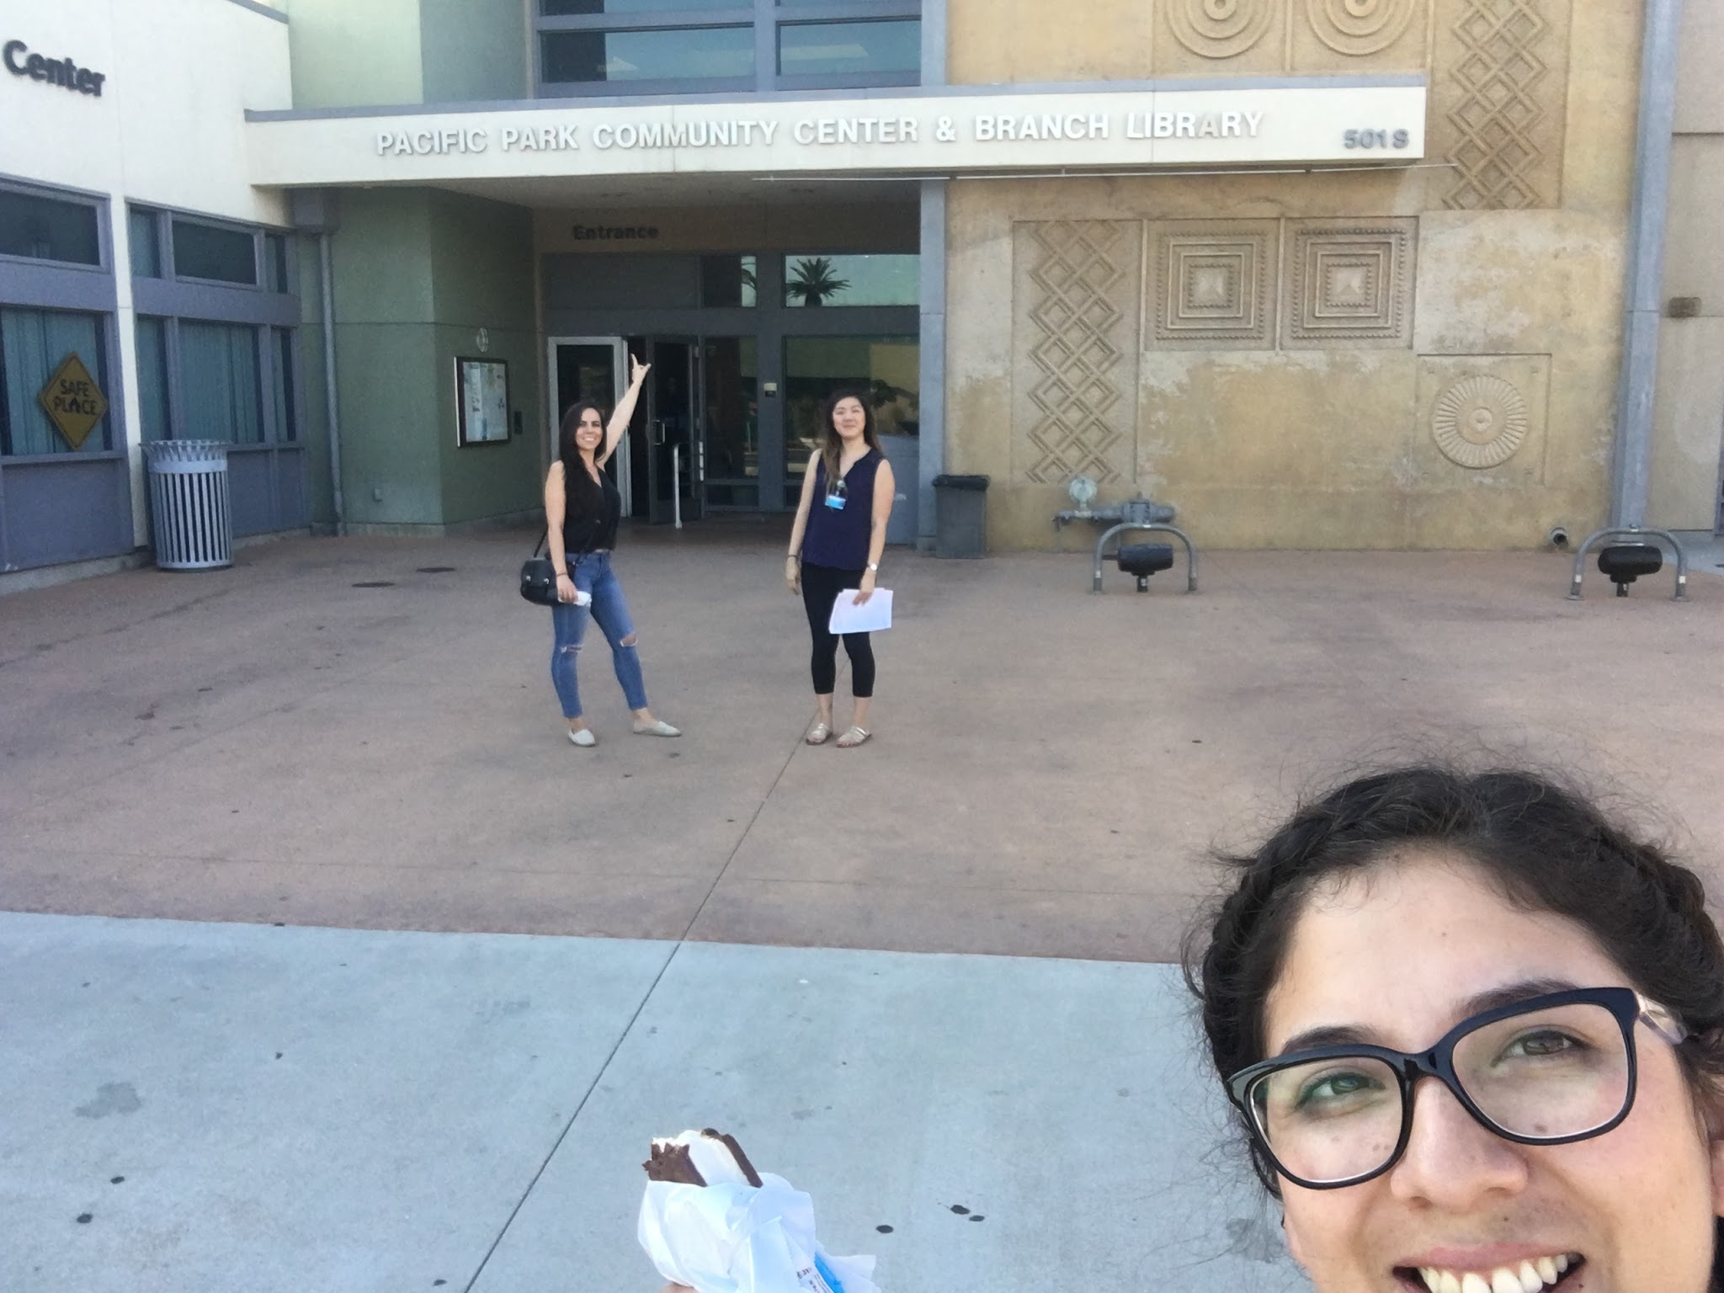
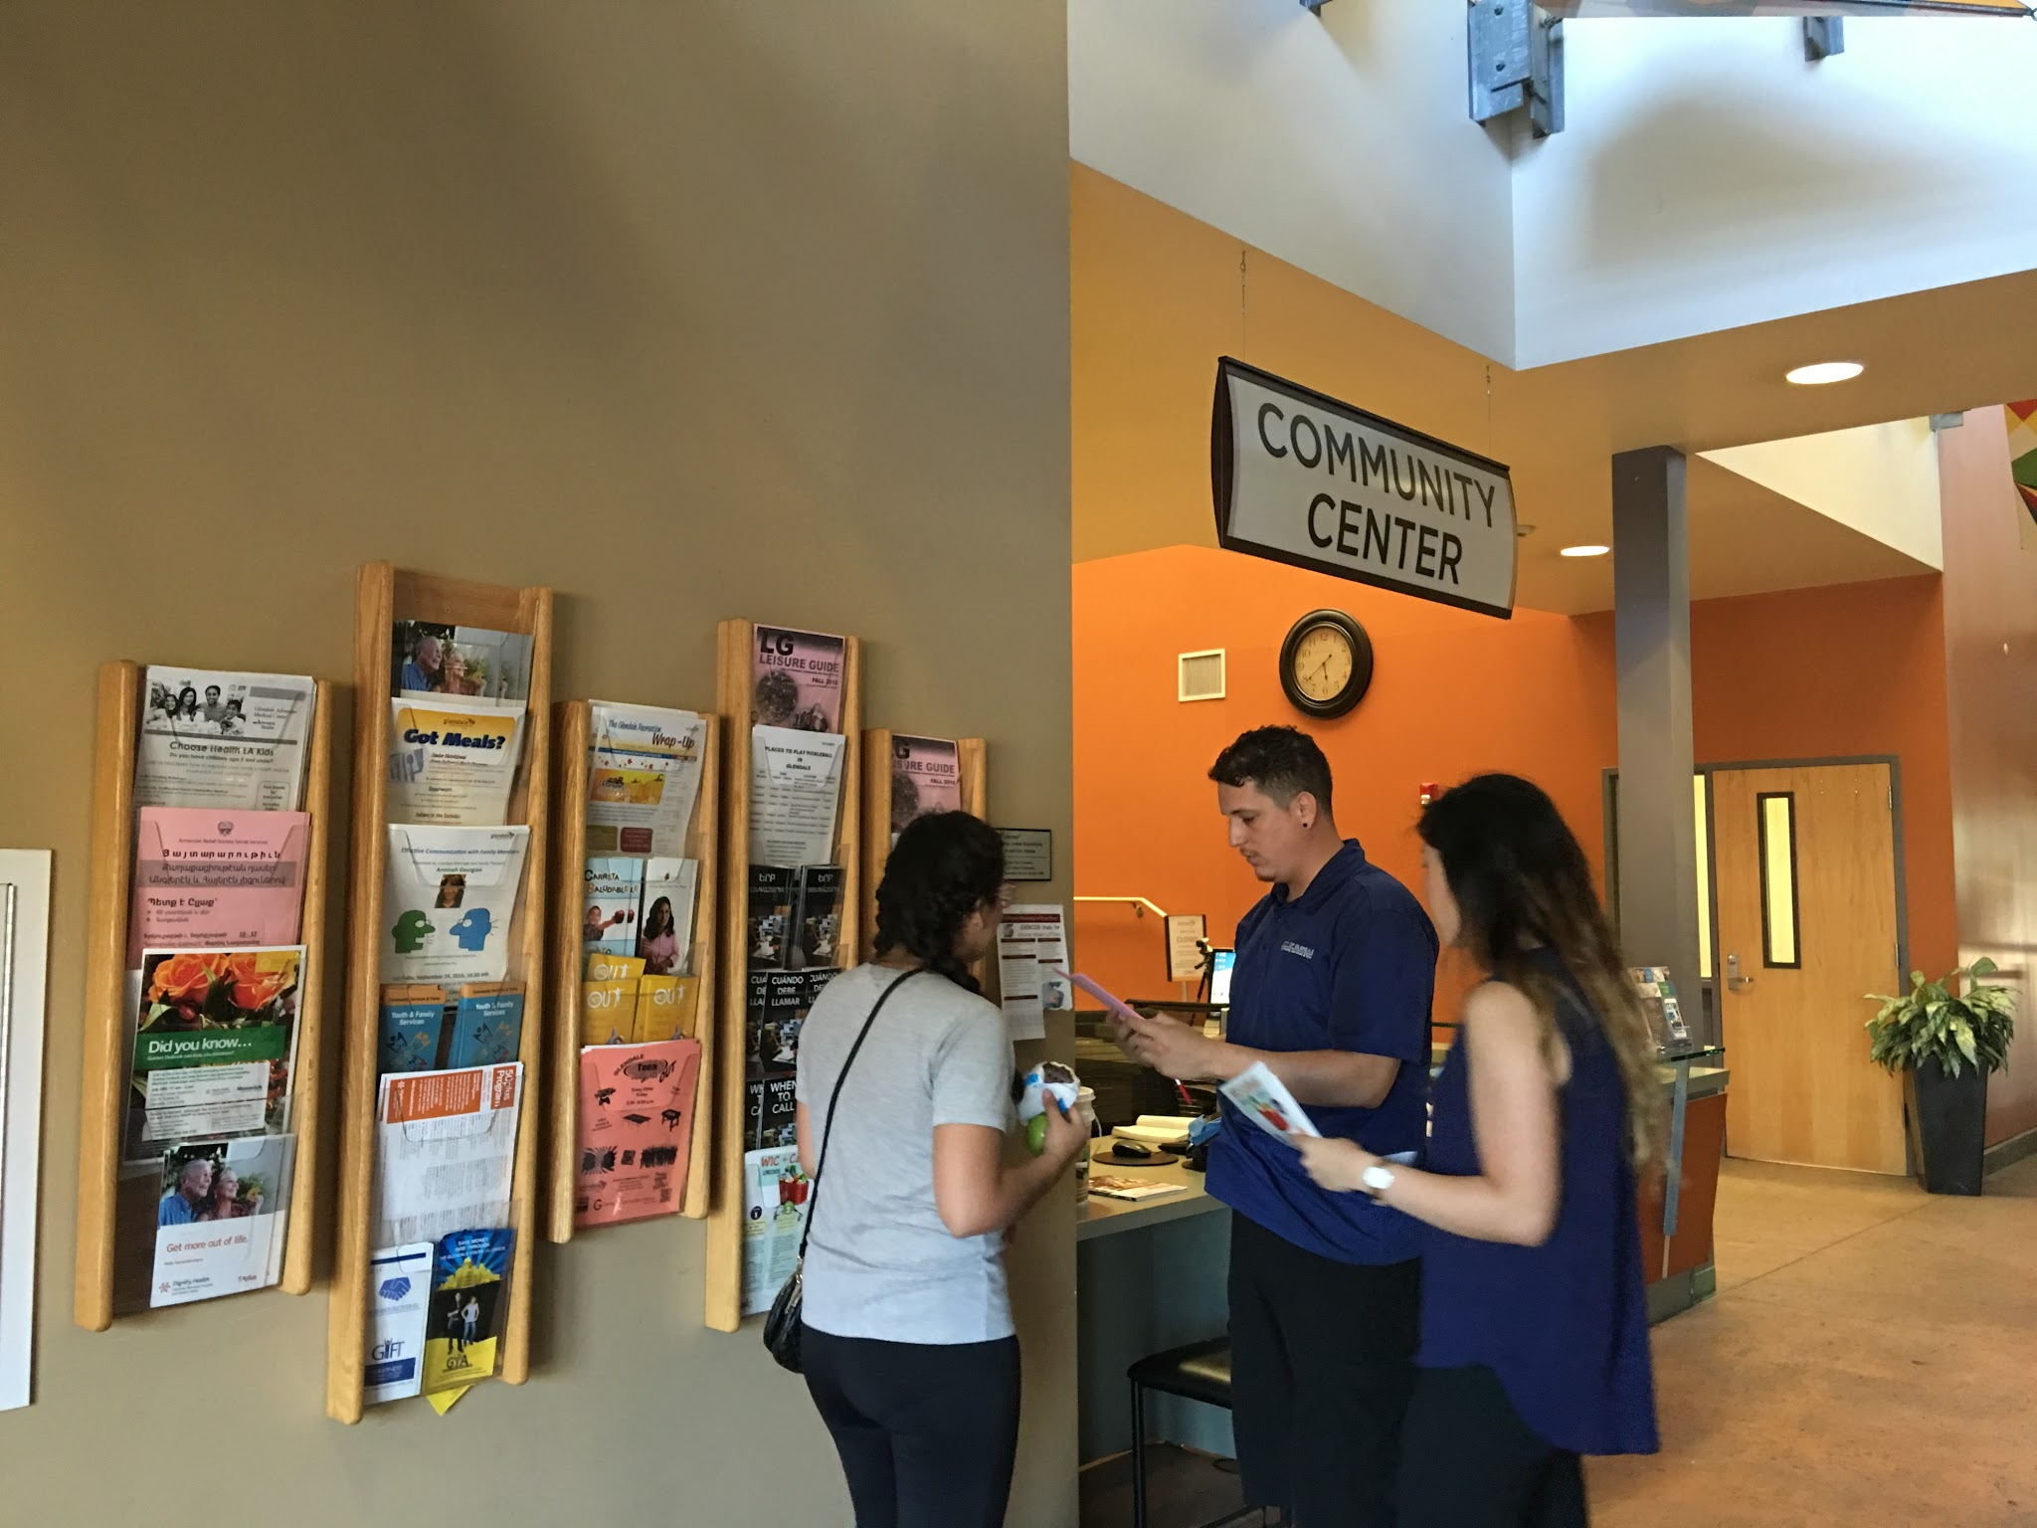
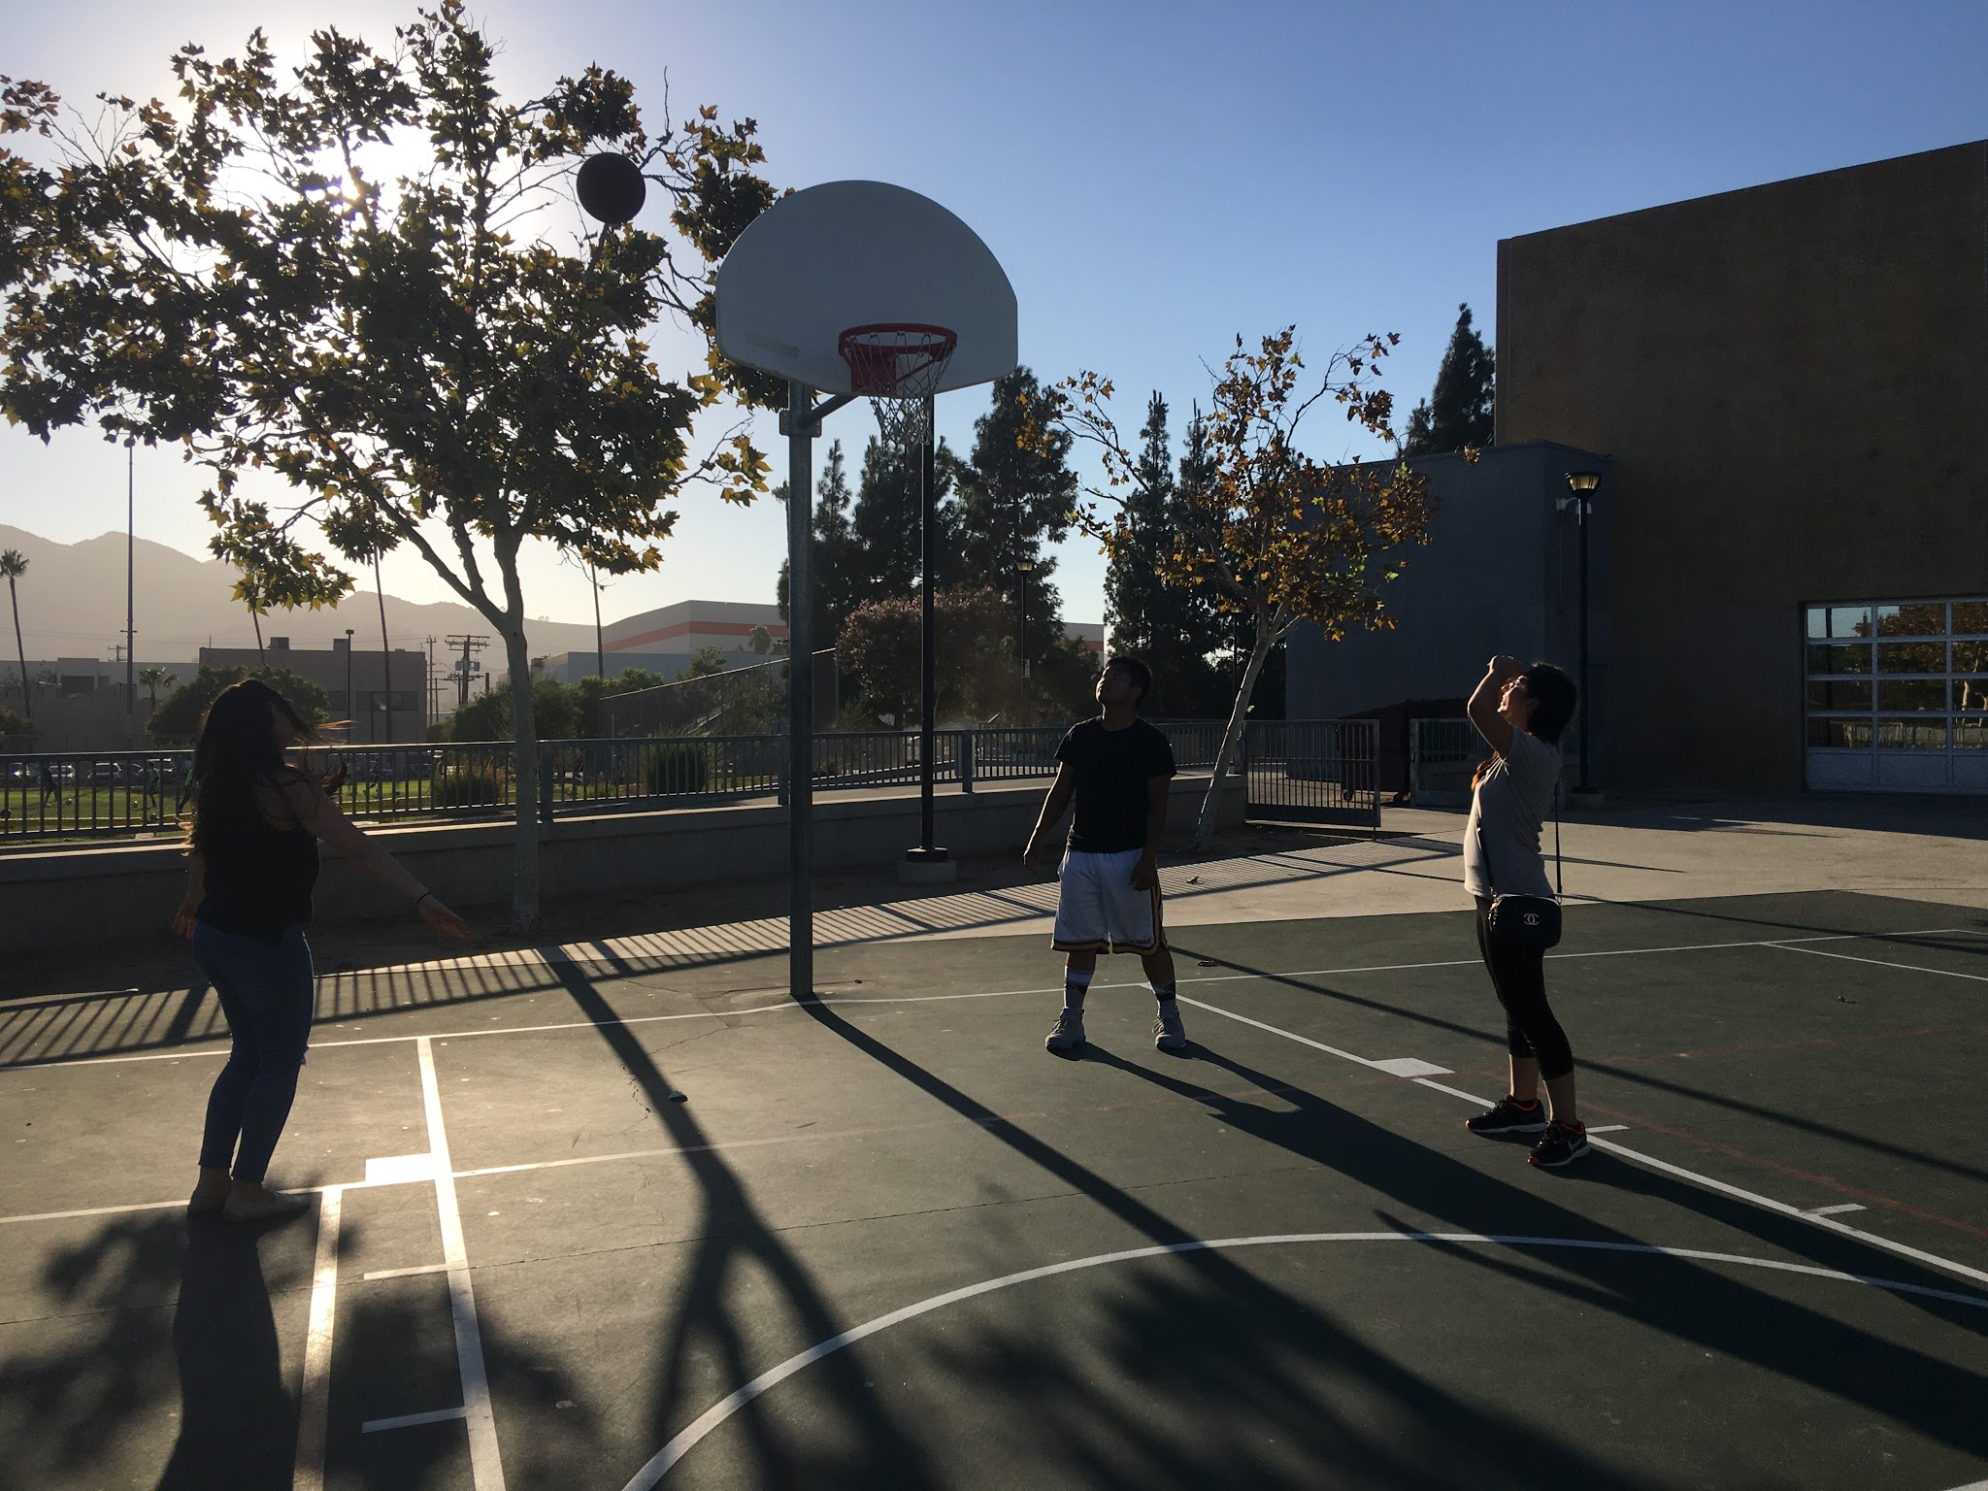
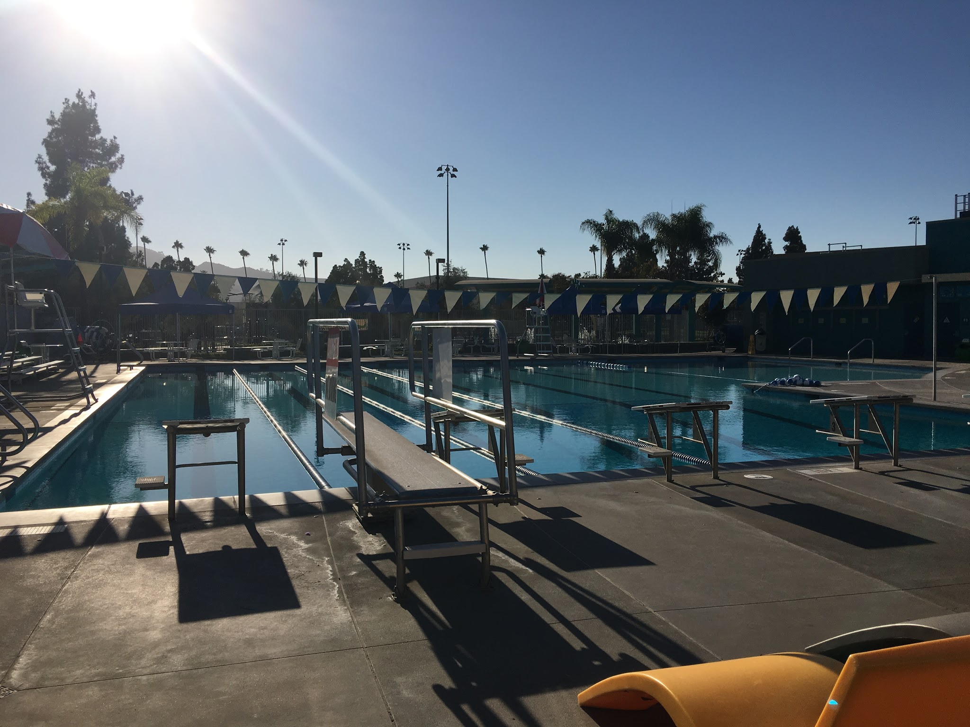
Community Centers
Pacific Park Community Center & Branch Library
501 S Pacific Ave | Glendale, CA 91204

Slide 14
Community Centers’ Services
Senior Nutritional Home Delivered Meals Program
Free Noncredit ESL Classes
Glendale Teen Night Out
Parent’s Night Out
Effective Communication with Family Members
  focus on the impact of effective communication within family system
  touch upon relationships between all members of a family, including extended family
Youth Visual Arts, Dance & Sport Classes
Youth Family Services Program
  serves youth & young-adults (ages 14-21) and families of Glendale by linking them with community-based social service providers & public service agencies
  services are FREE to Glendale residents

Slide 15
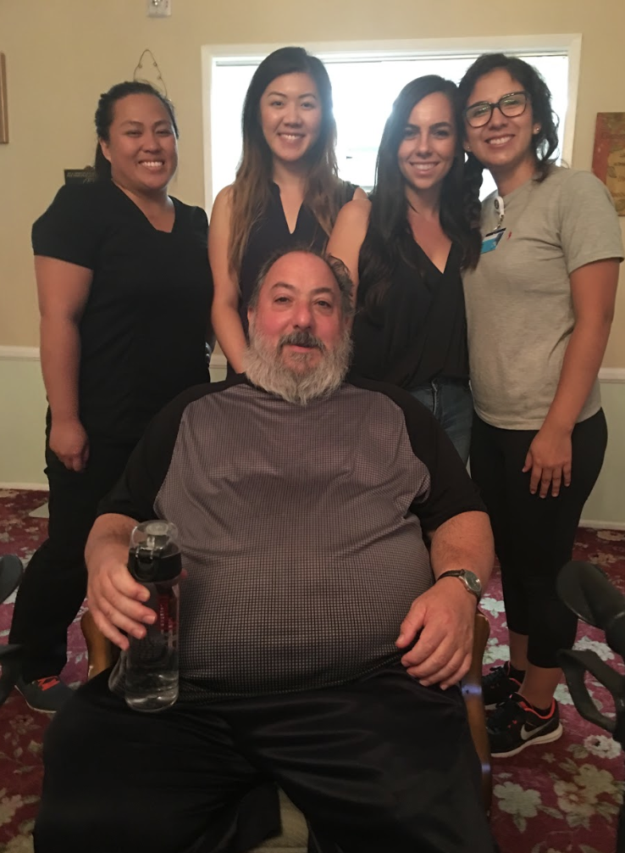
Senior Citizens Center
Glen Park at Glendale – 1220 Mariposa St.
Assisted Living
Provide care for individuals with early stages of memory impairment
Alzheimer's / Dementia Memory Care
Stimulating Activities Independence
Tailored Personal Video Surveillance
Care
Memory Impairment Community Outings
Specialists

Slide 16
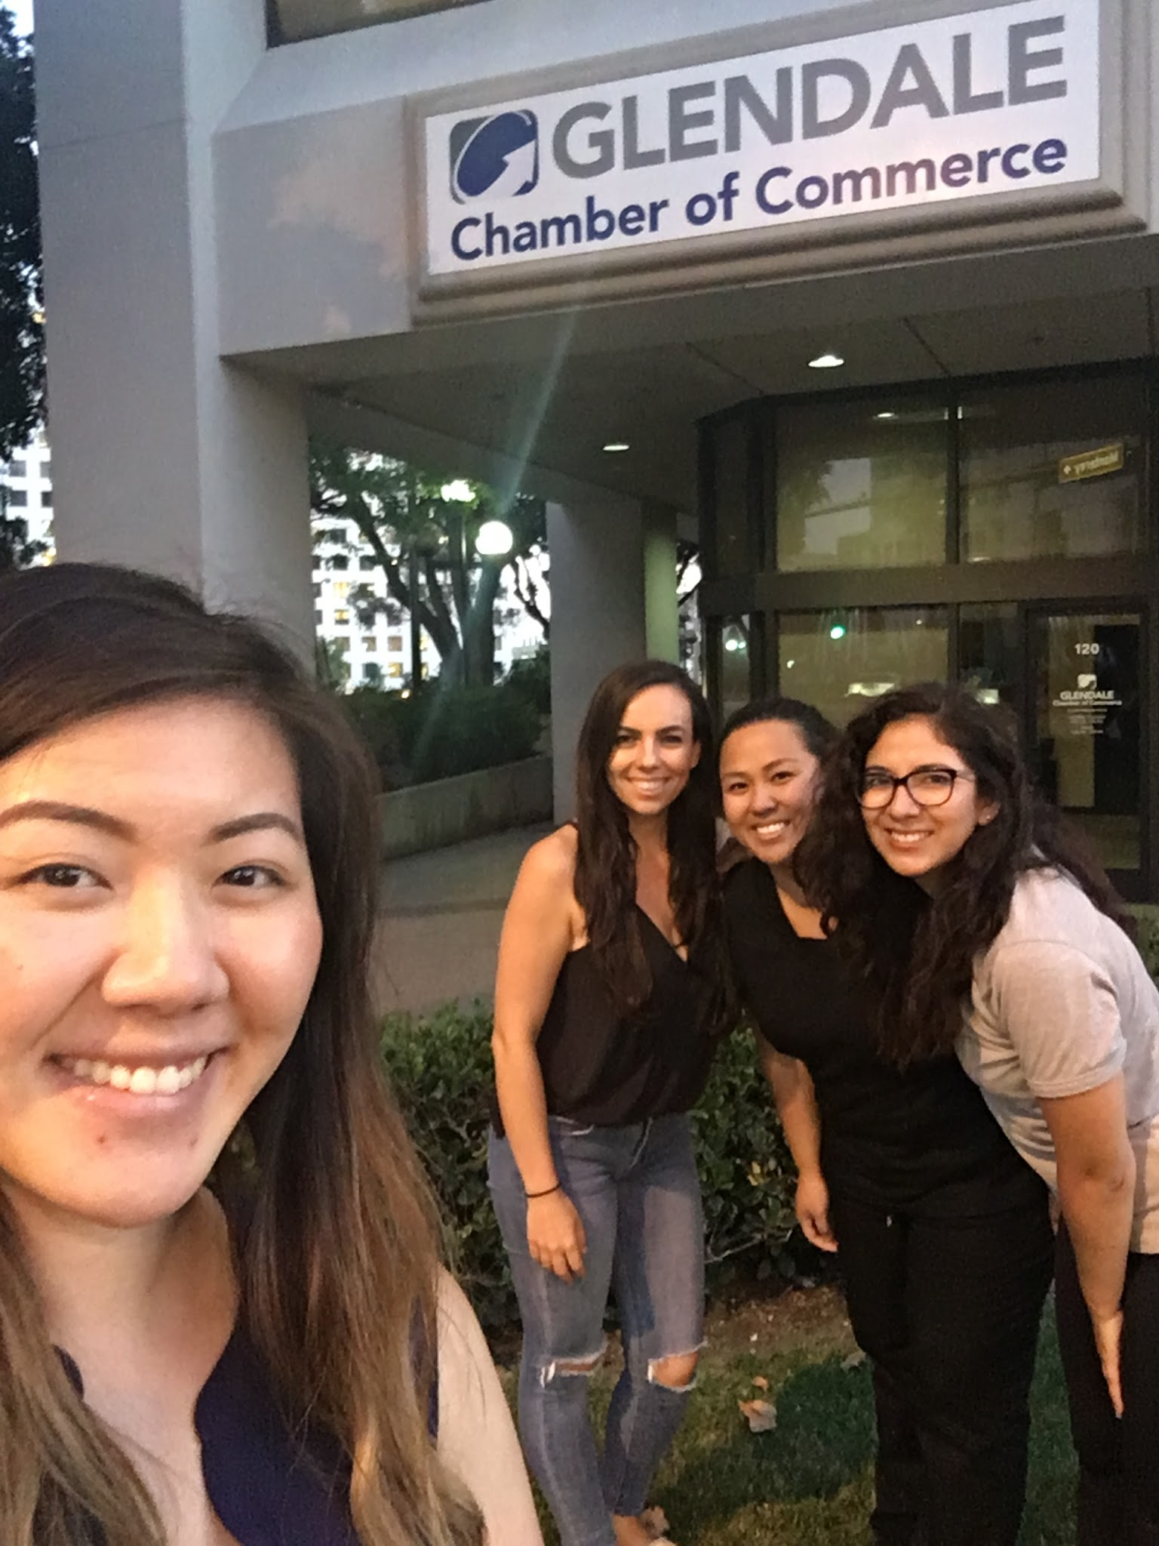
Chamber of Commerce
701 N. Brand Blvd., Suite 120, Glendale CA 91203
Mission
  Serve the needs of business & improving the quality of life in the community
The Voice of Business
  serve more than 850 businesses & organizations
Large & Active Chamber
  Offers a variety of benefits and opportunities for “building the business”
  ie. Business Safety & Security to Advocacy & Government Relations, Leadership Glendale program
  Collaborate with the City of Glendale & other area governmental & civic organizations when business & community improvement matters are discussed and planned

Slide 17
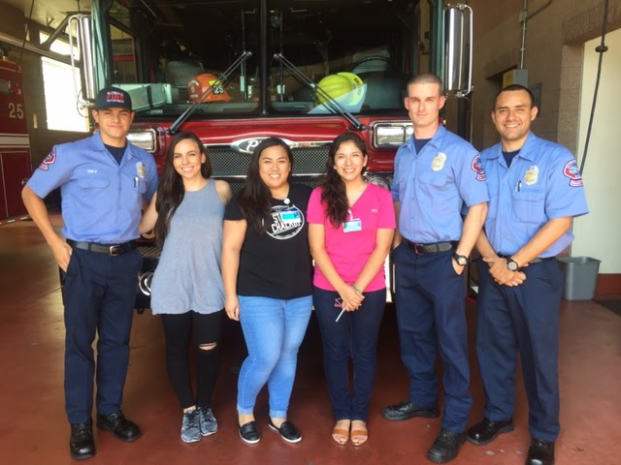
Glendale Fire Station 25
353 N Chevy Chase Drive Glendale, CA
Mission:
The mission of the Glendale Fire Department is to protect life and property by providing the highest level of service to the community.
Disaster/ Emergency Preparedness
Disaster Drills
When to call 911/ What to say
Fire Prevention
Neighborhood Services
Bereavement Support

Slide 18
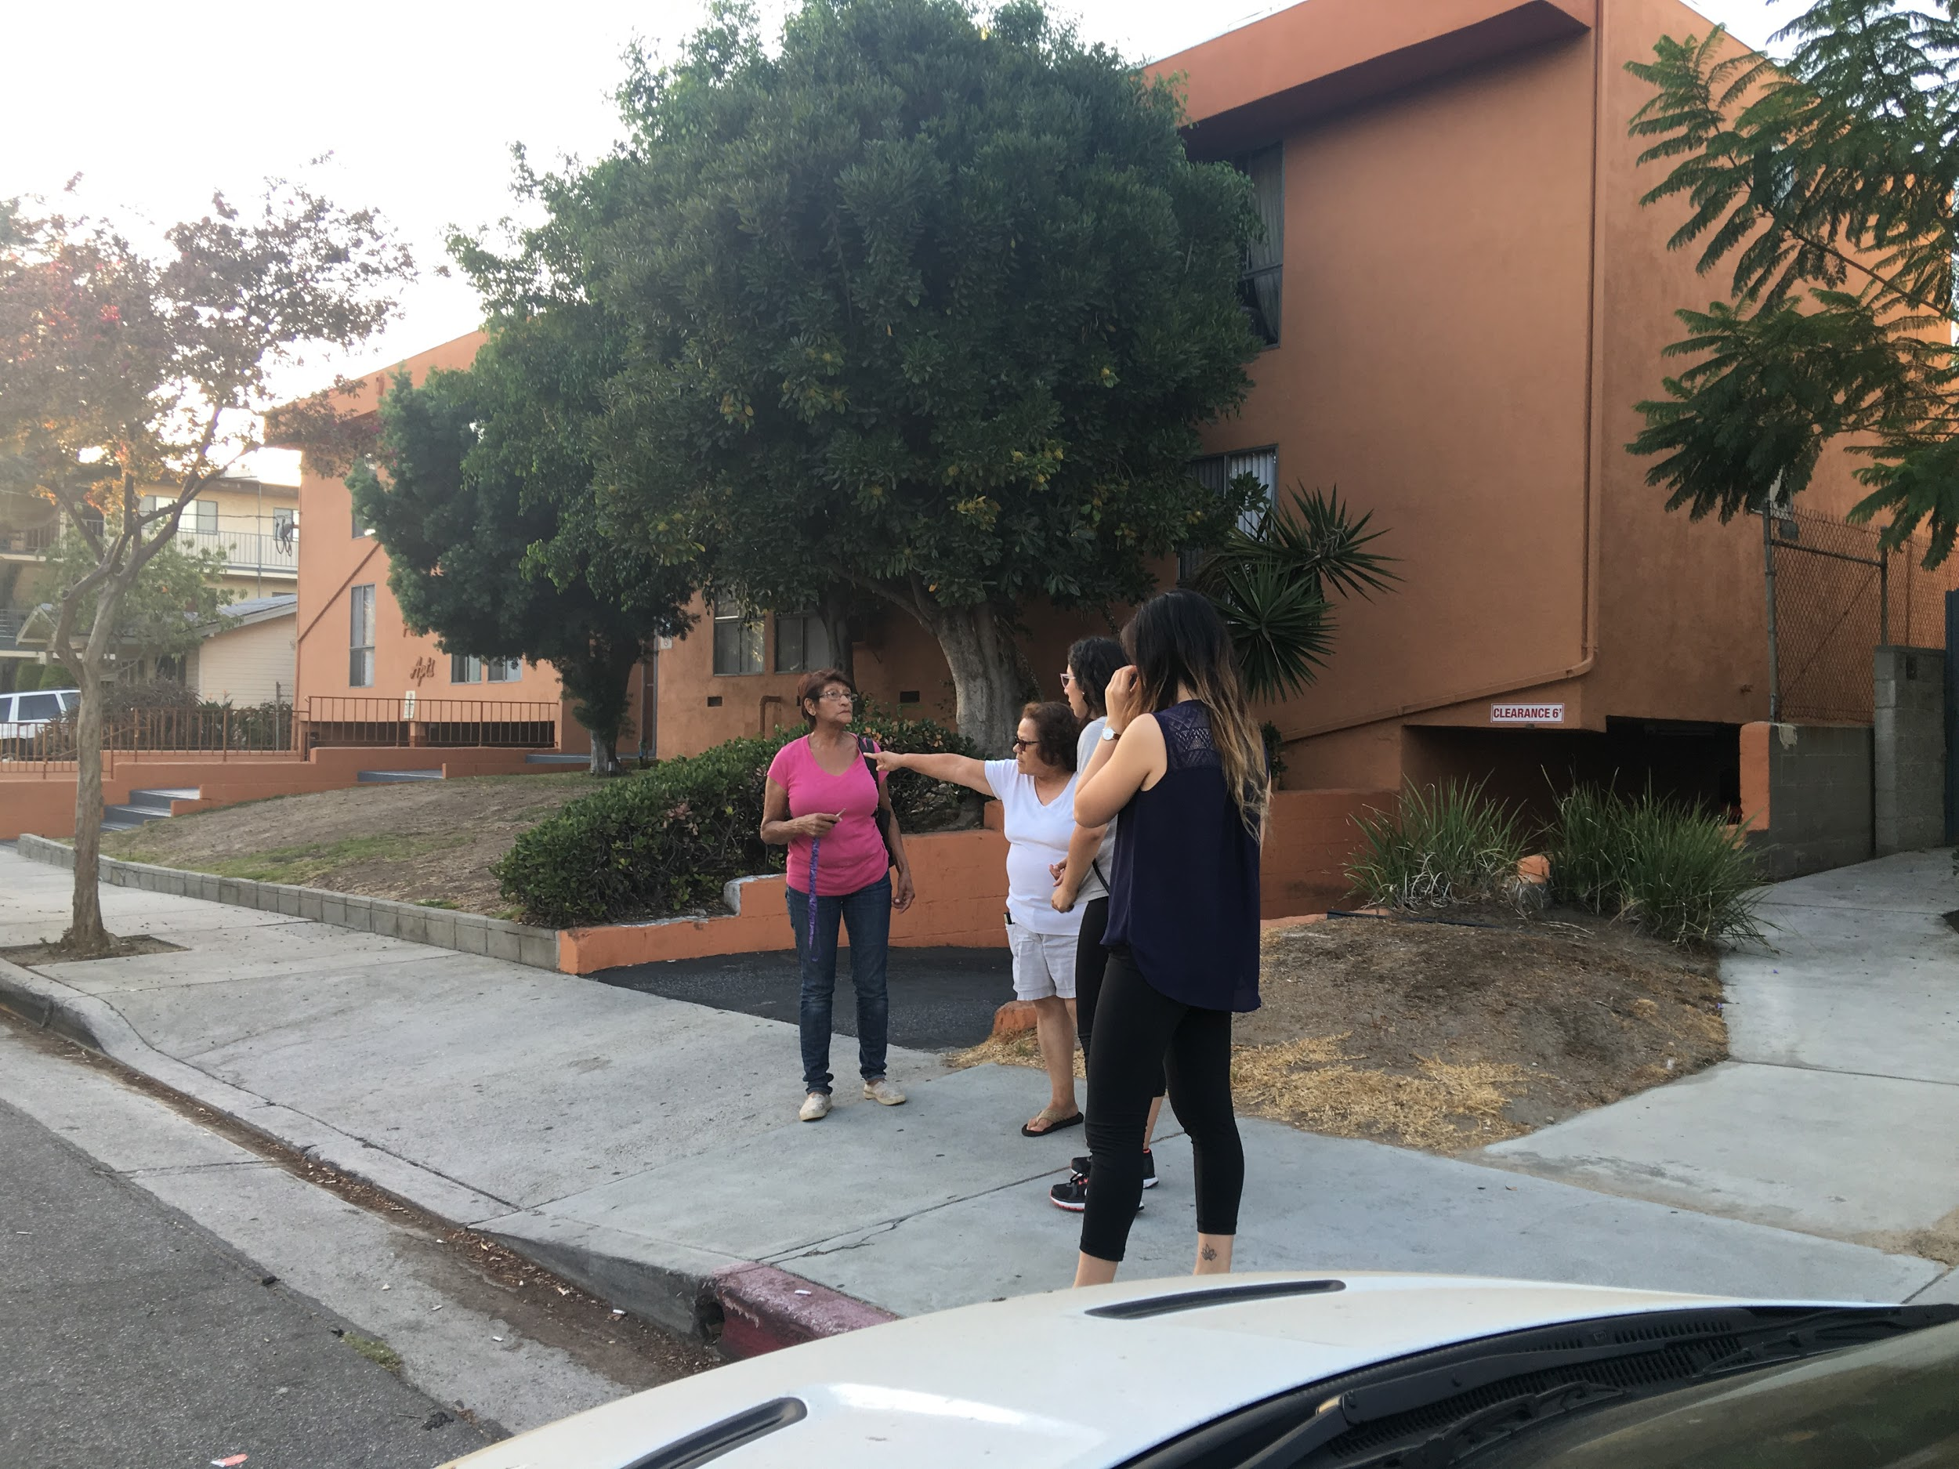
Interview
M.S.
Female
Hispanic
54 Years
Glendale resident for 20 years
One room apartment
$1100/ month
Likes to come to the park

Slide 19
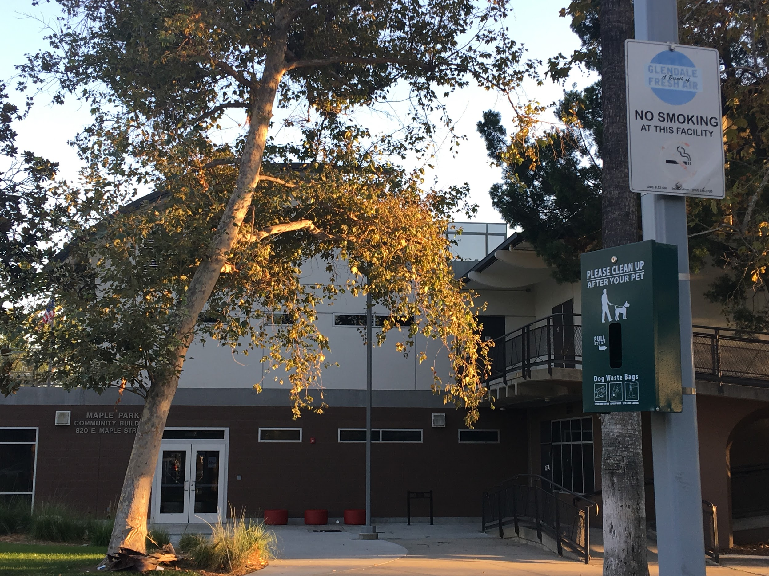
Interview
What is it like living in your community?
It is good, although I wish people would slow down with they are driving.
It is expensive to live in this city. It costs $1100 for a 1 bedrm & 1 bathrm. There is no rent control.
What are this community’s strengths? Weaknesses?
What I like about Glendale is the fact that there is a lot of police enforcement, let’s say if I call 911 they will show up in a heartbeat. Now, what I don’t like about Glendale is the crazy drivers. I can’t hardly stand them. You would think that living right in front of this park they would slow down for the kids but they don’t care. About two years ago a lady passed away right here, she was just walking across the park and the car run her over.
What is the greatest health problem in this area?
Smoking, there is kids in this park and people still come and smoke.
What seems to be the gossip center or the informal communication
network of this community?
If I were to hear about something that occurred and didn’t know about then
i’ll go and ask my neighbors or people who come and hang out at the park
or maybe the news.

Slide 20
Interview cont.
How is employment for people these days?
Not sure how to answer that, I think it’s okay I work in Ross down the street and so far it’s good.
Do they have a family doctor? How accessible is the doctor?
Yes I do have a doctor, he is very accessible and easy to reach.
What would it be like to be elderly or homeless in this community?
God, that sounds horrible I mean I’m already old as you can see but homeless would be very tough. Just don’t do drugs and you’ll be fine.

Slide 21
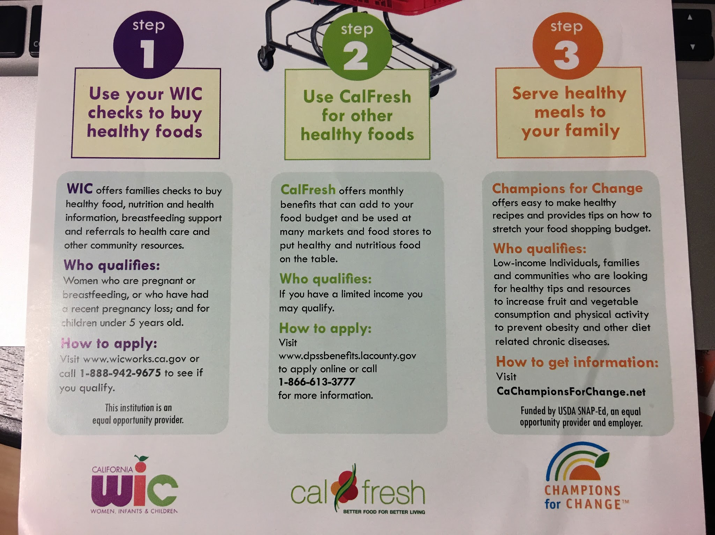

What would it be like to be a young single teenage mother in this community?
A single mother living in this community could benefit from the many resources it provides
WIC + CalFresh

Slide 22
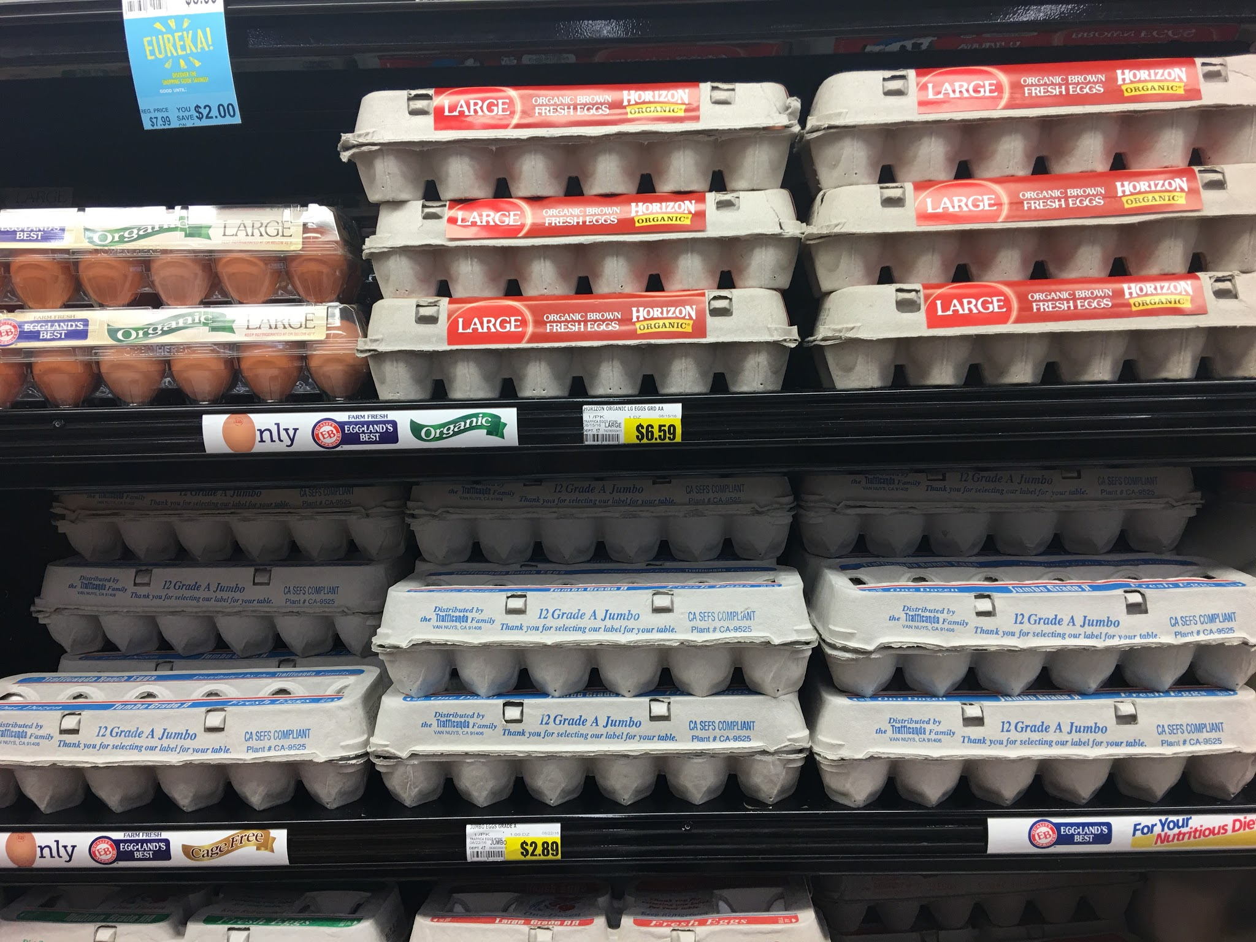
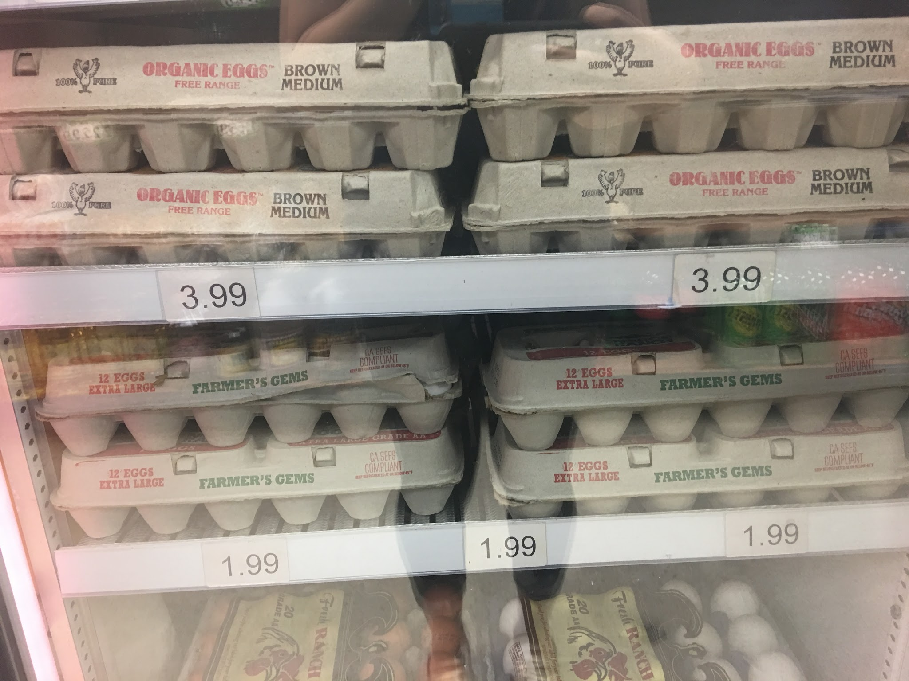
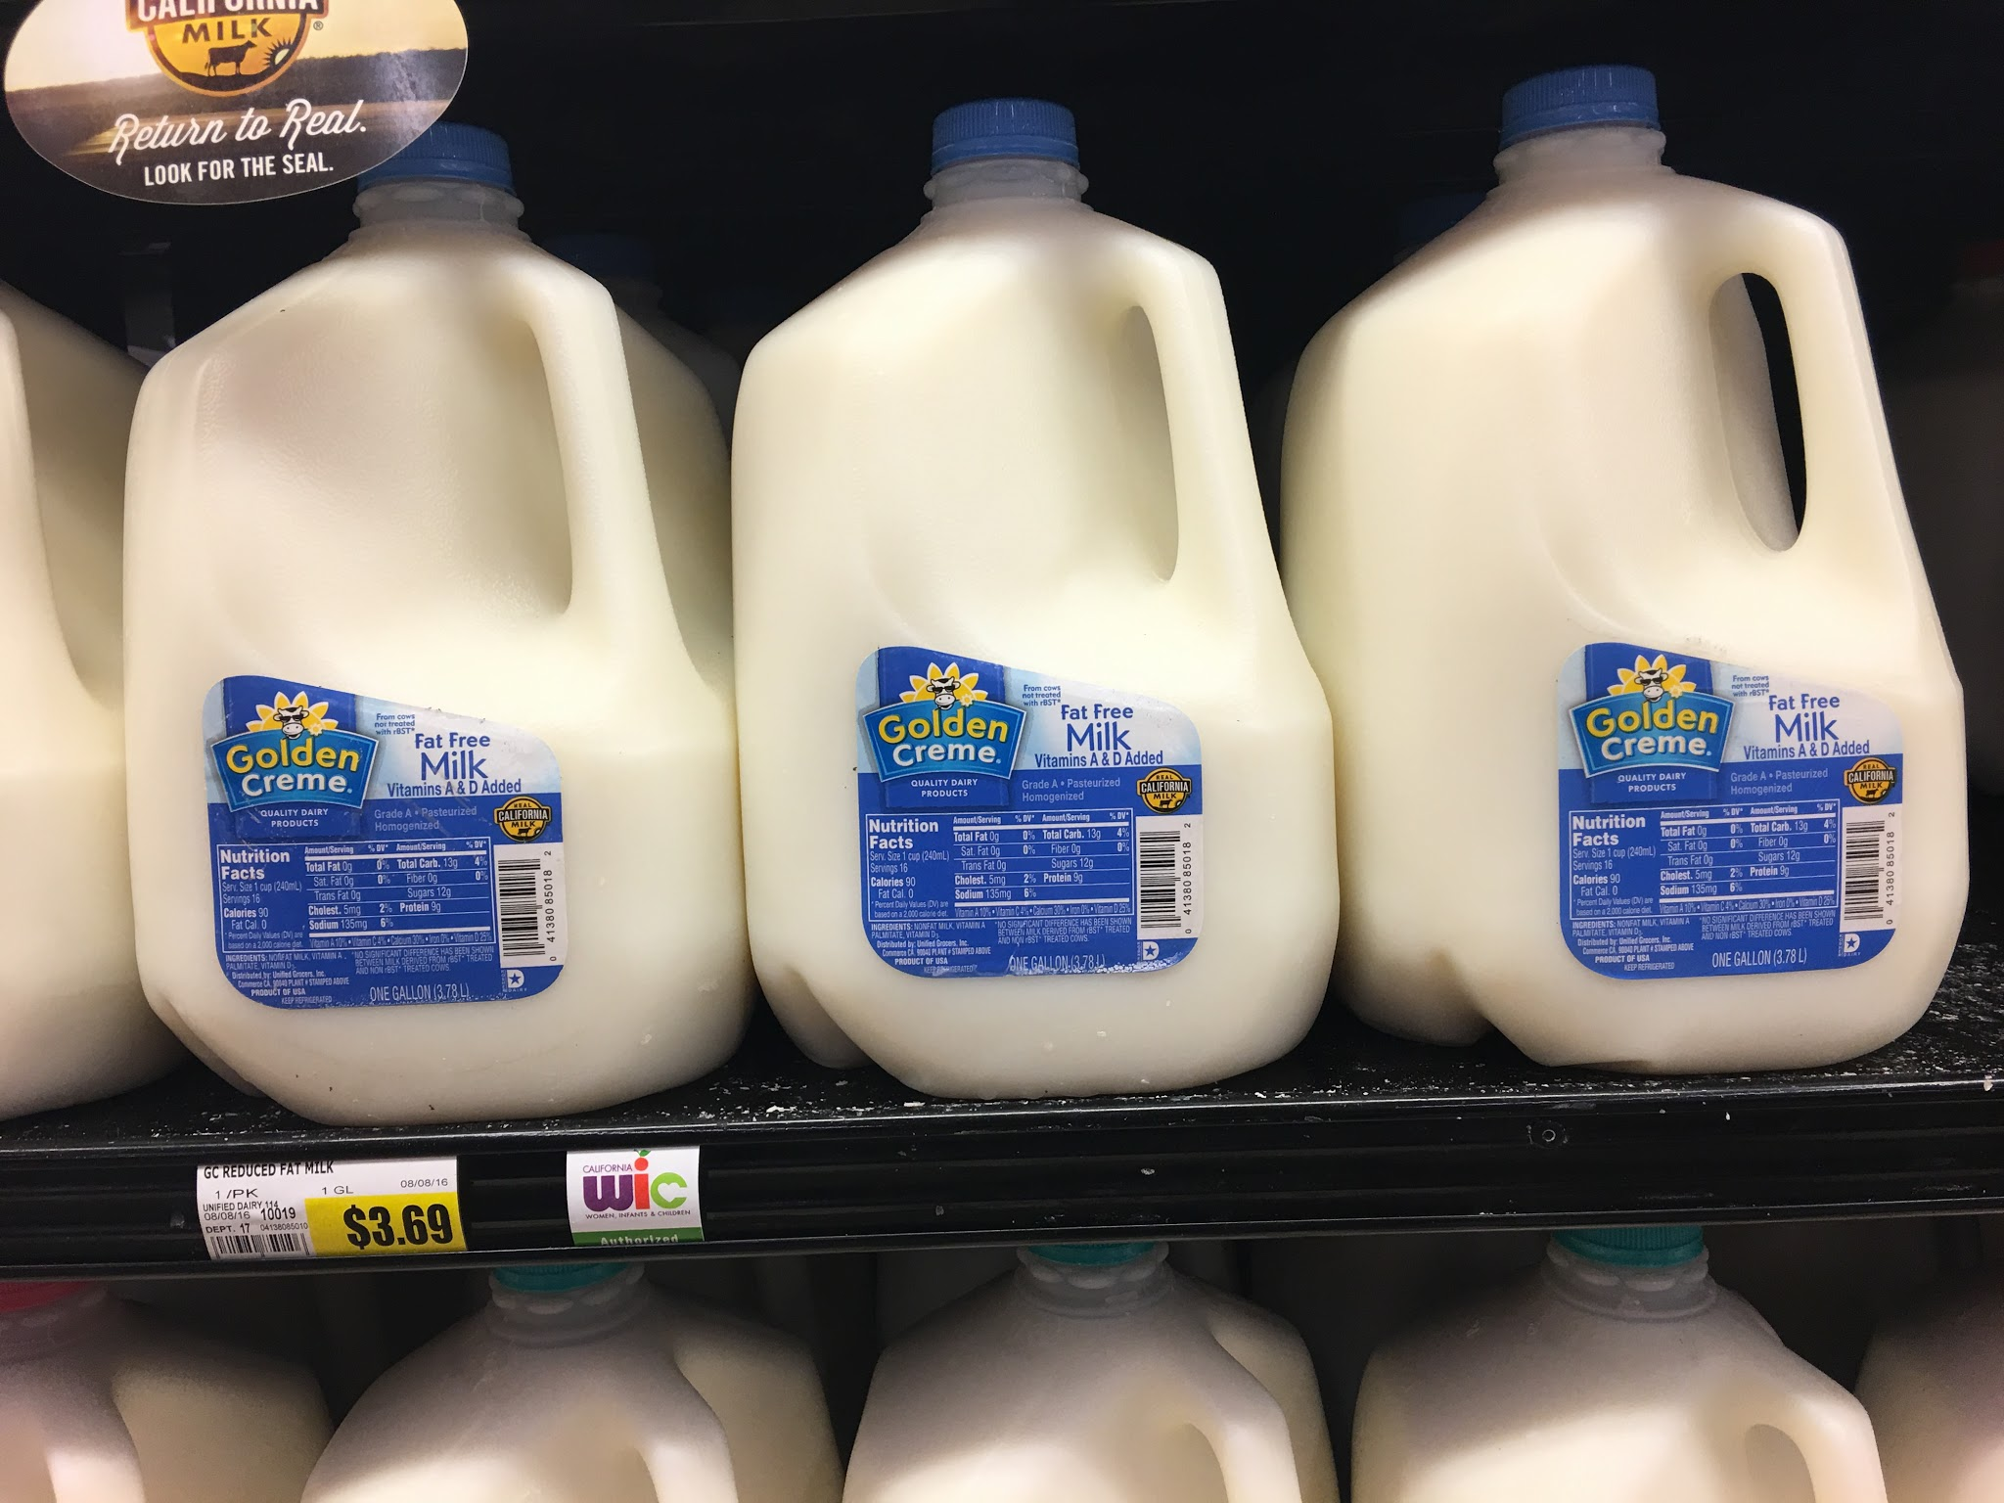
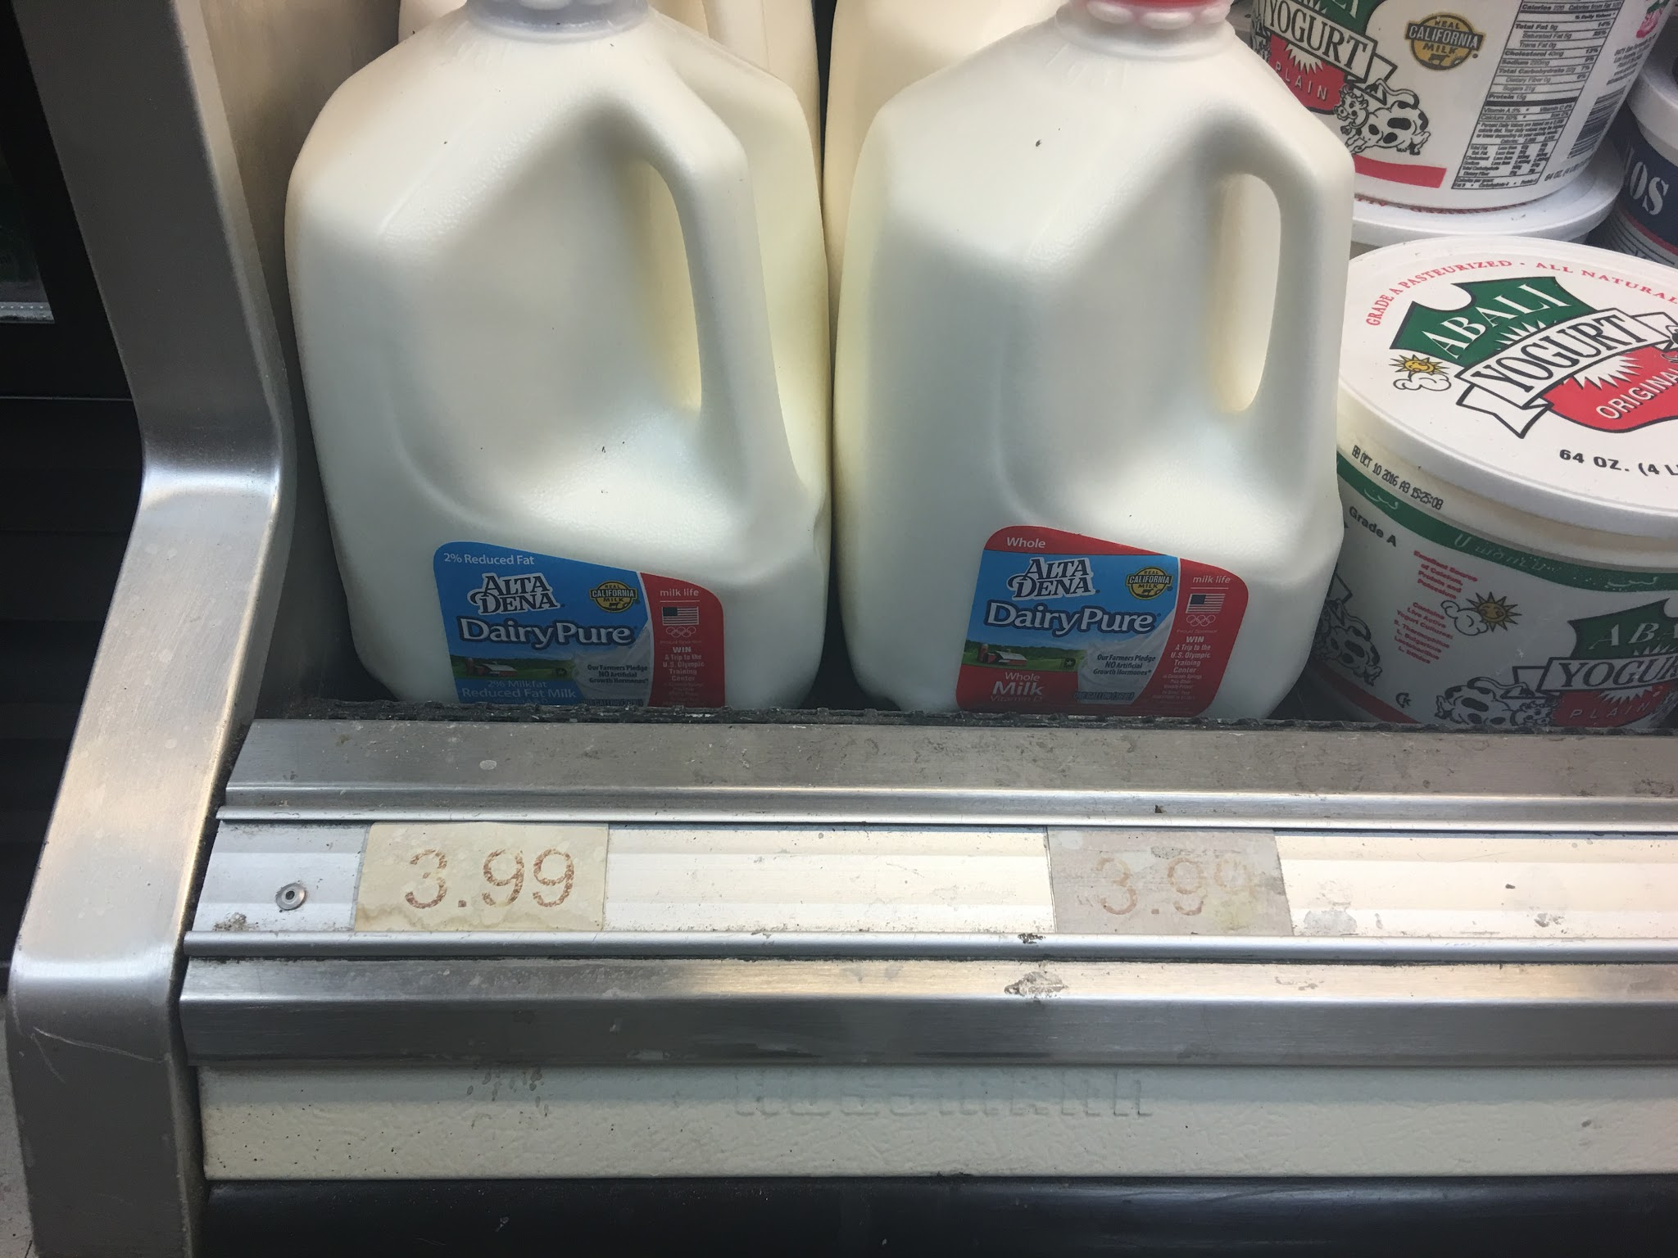
Supermarket
Jons Marketplace
Kozanian’s Ranch Market
EGGS: $2.89 $1.99
MILK: $3.69 $3.99

Slide 23
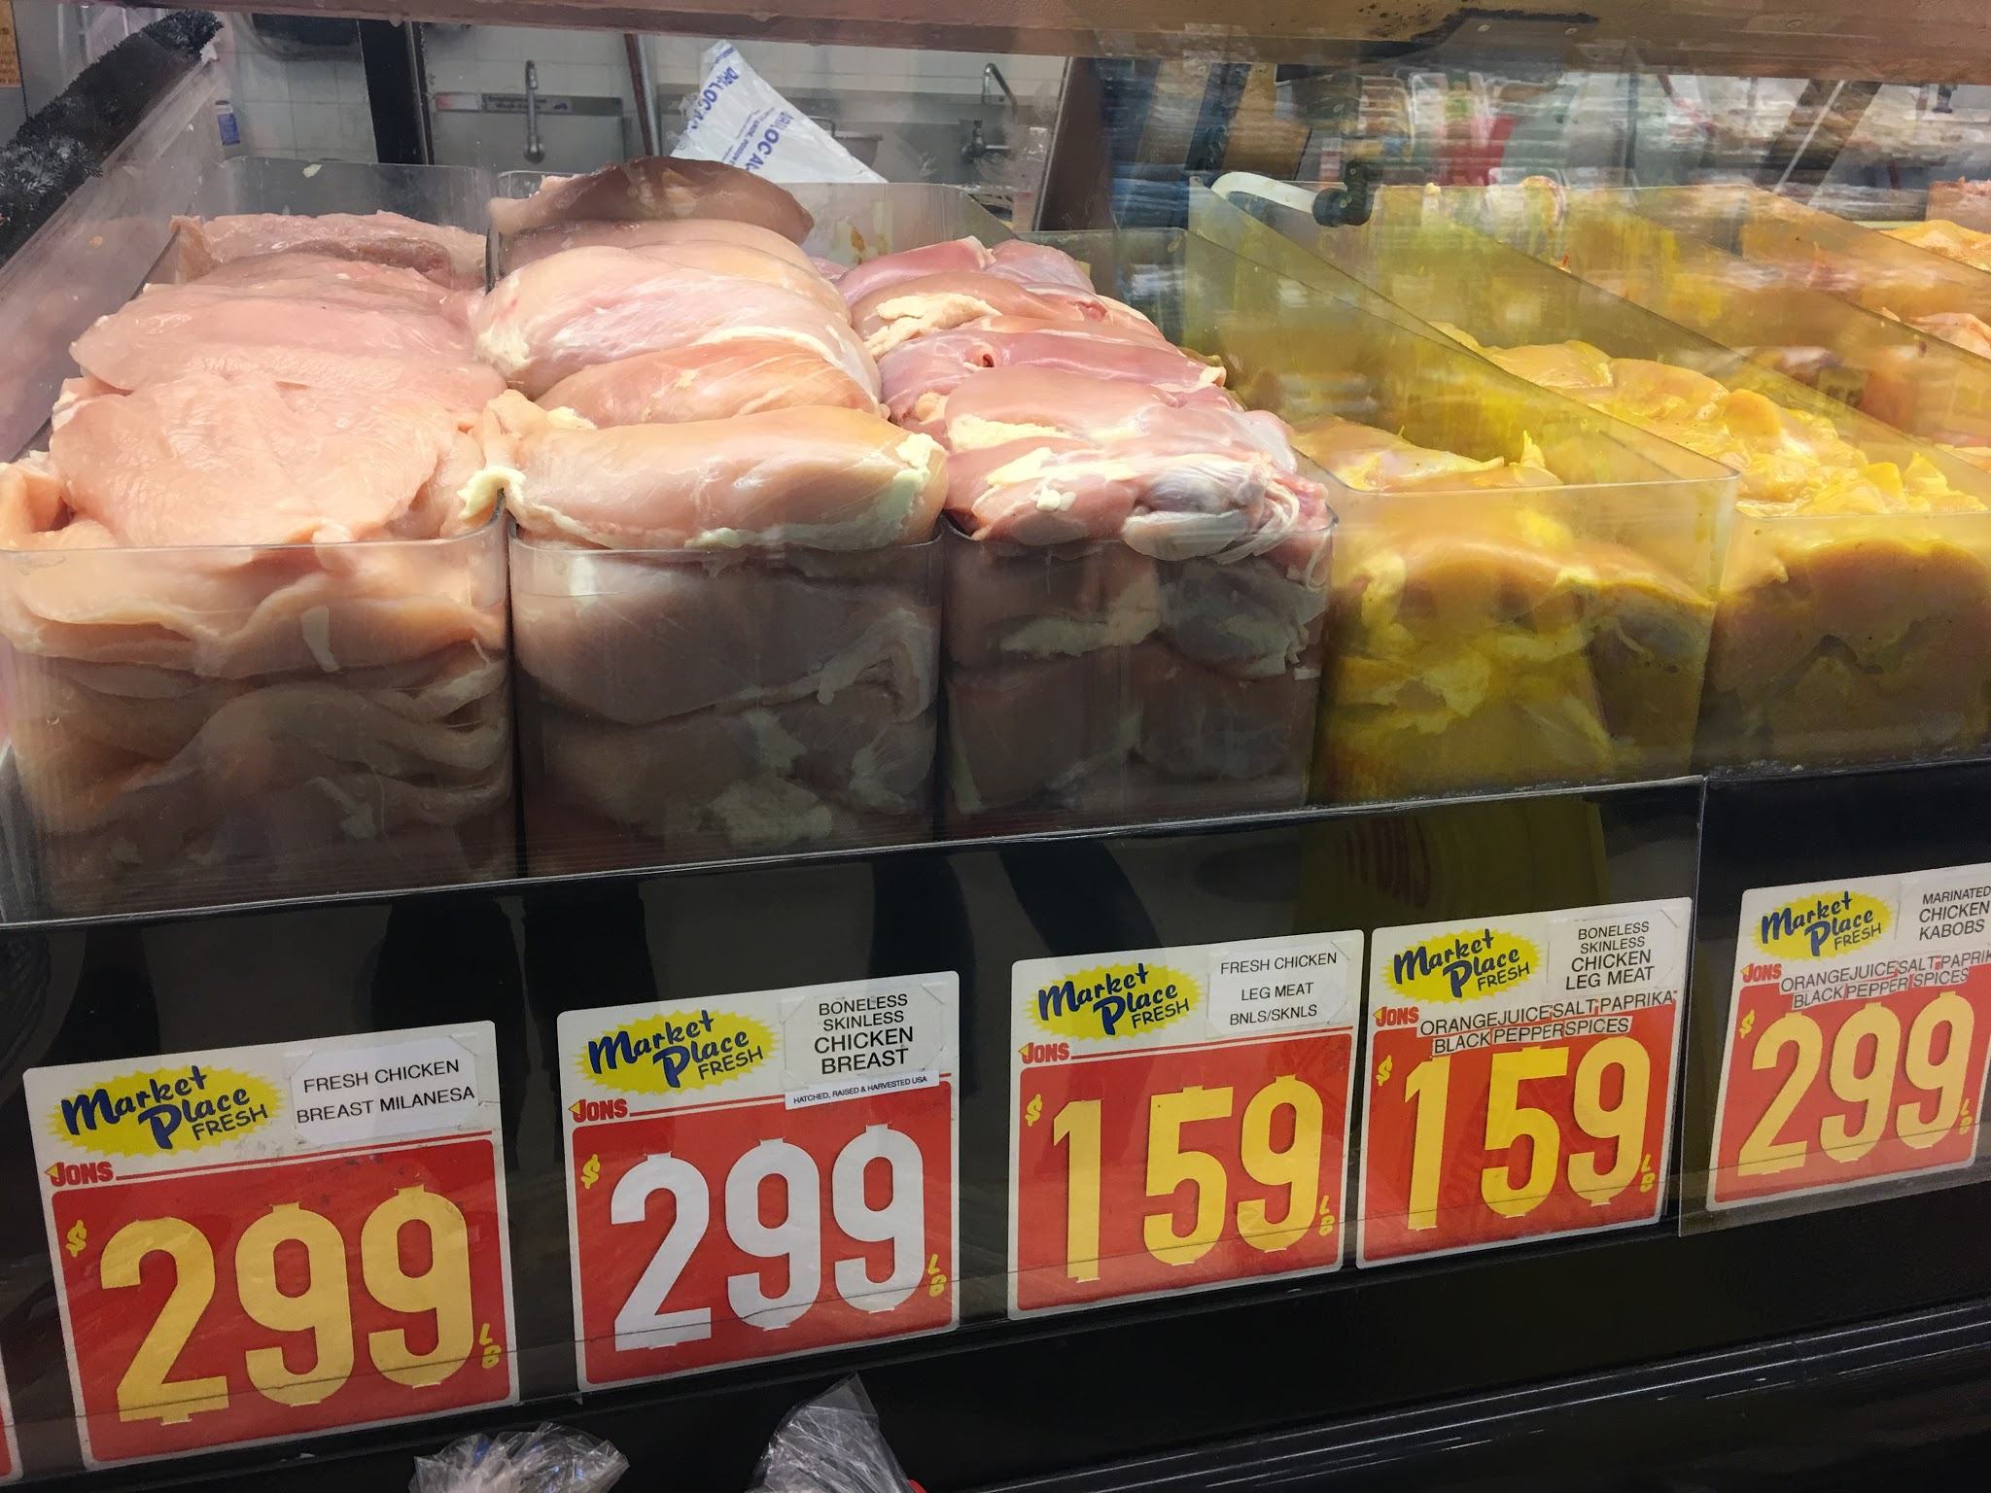
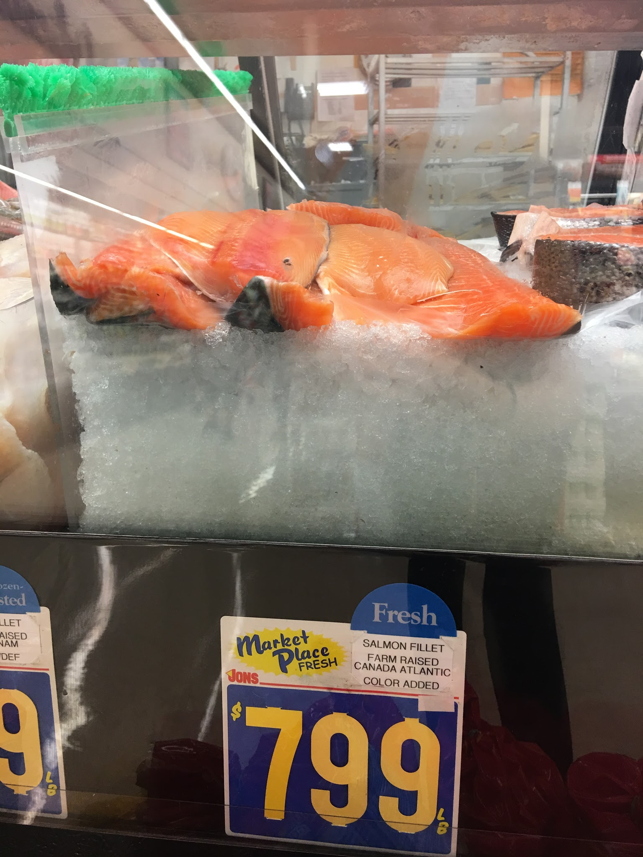
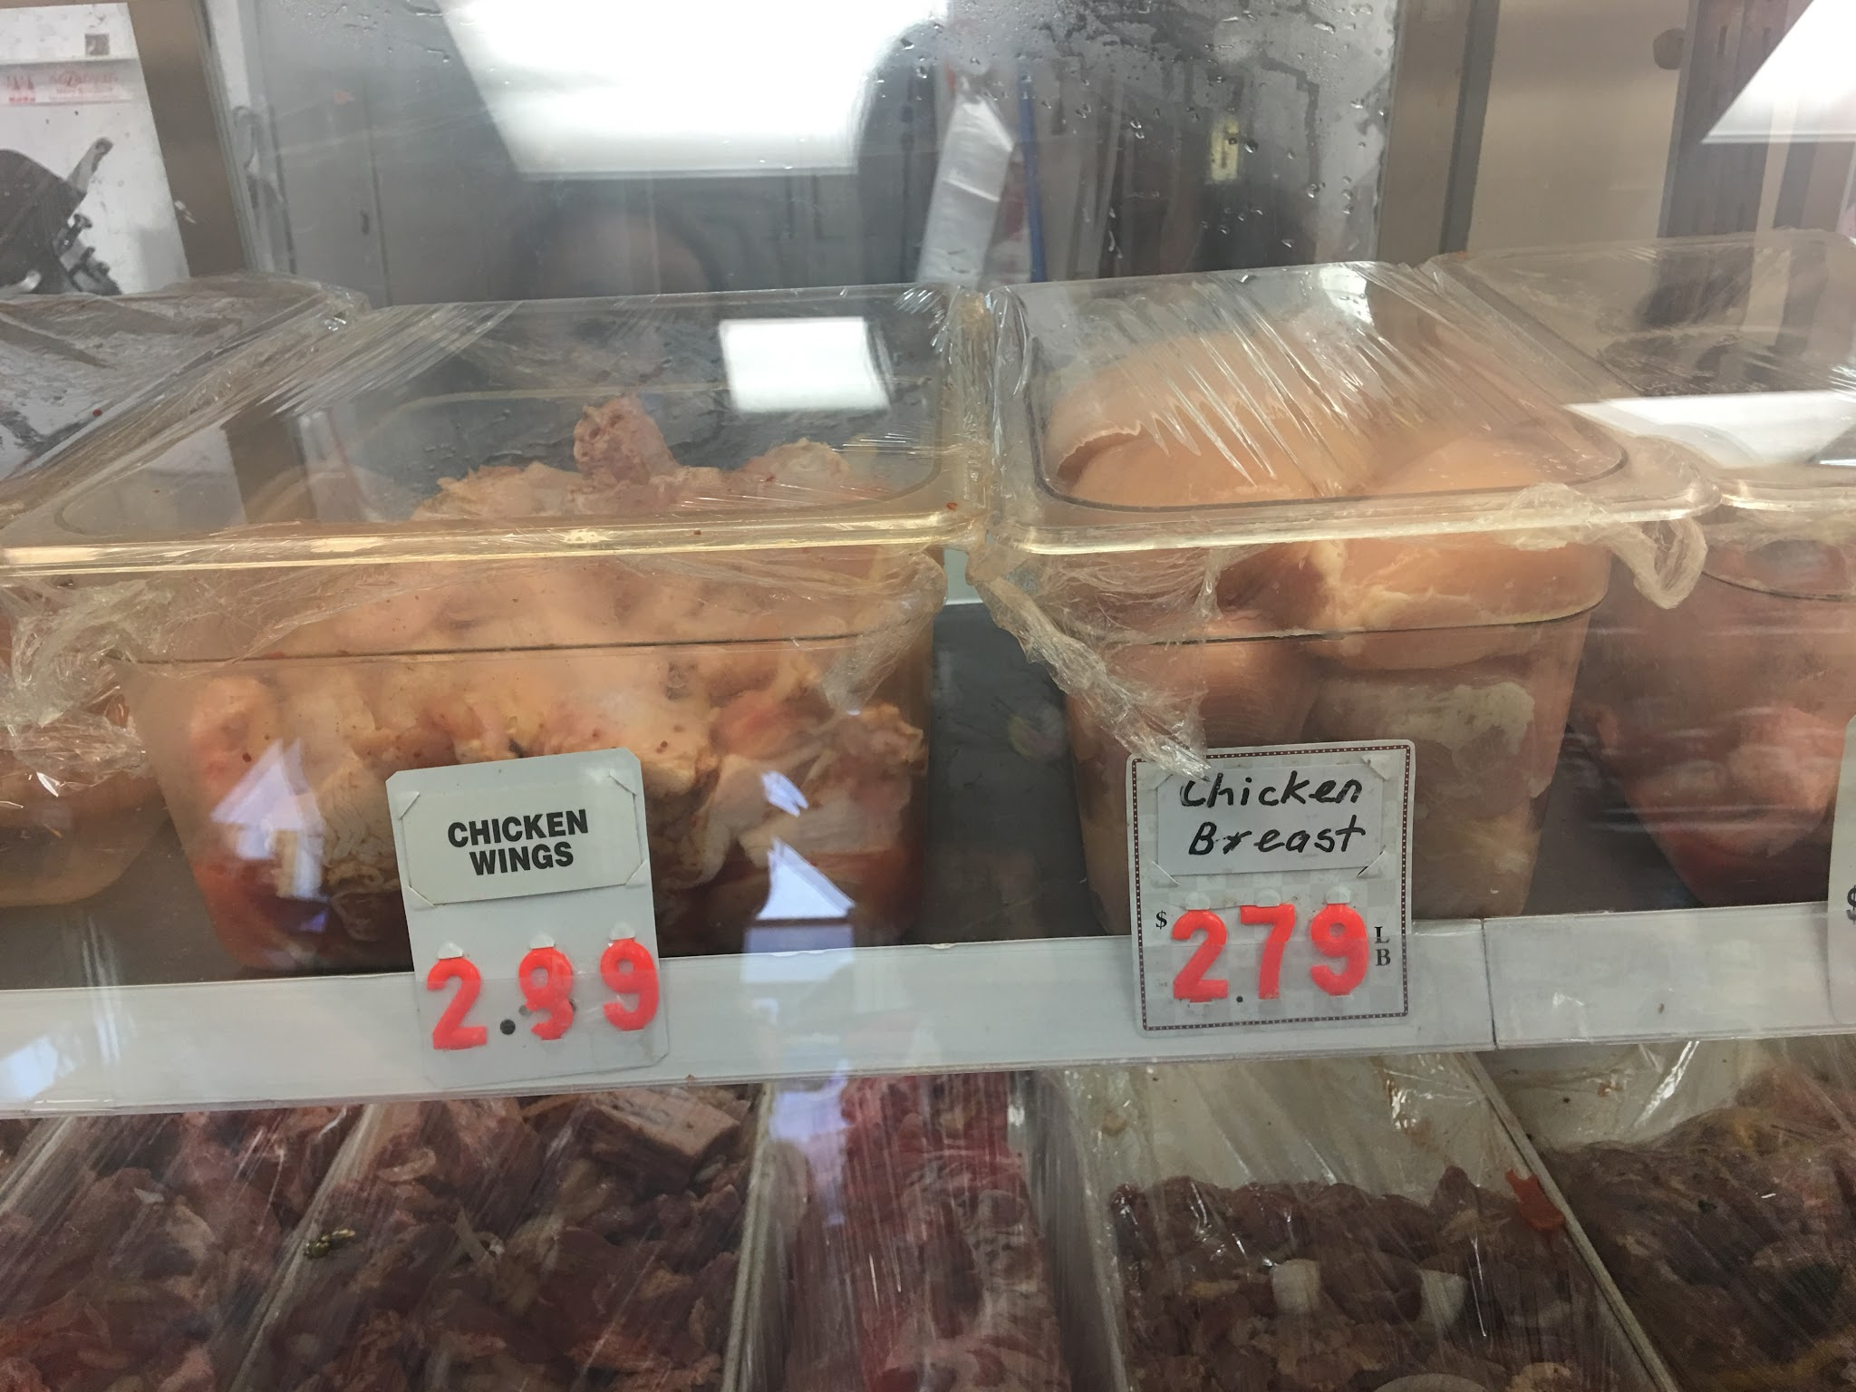
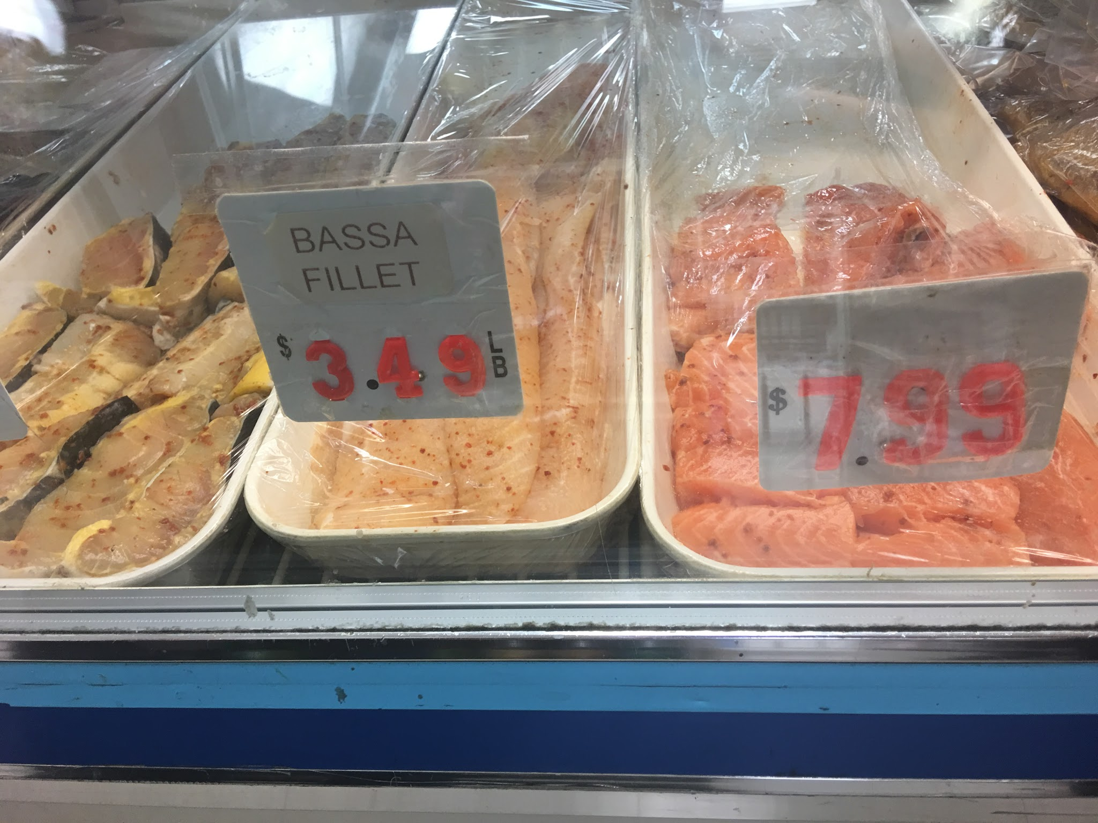
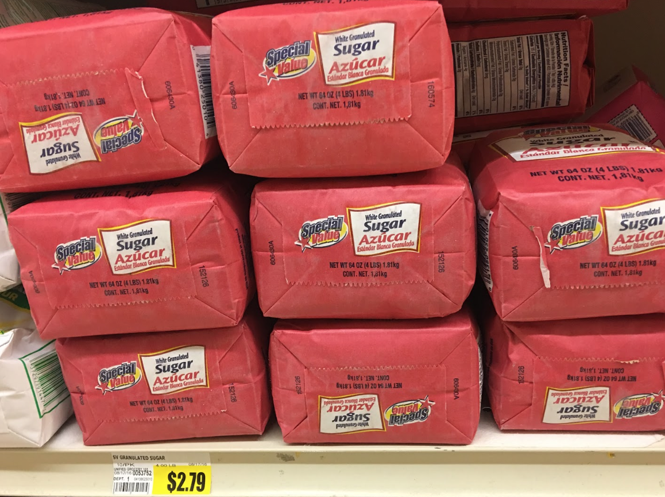
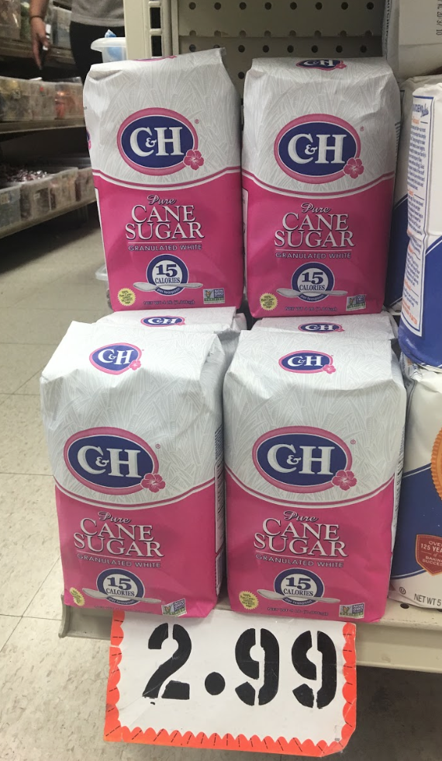
Supermarket
Jons Marketplace
Kozanian’s Ranch Market
Chicken Breast:
$2.99/lb vs. $2.79/lb
Salmon Fillets:
$7.99/lb vs. $7.99/lb
Sugar:
$2.79 vs. $2.99

Slide 24
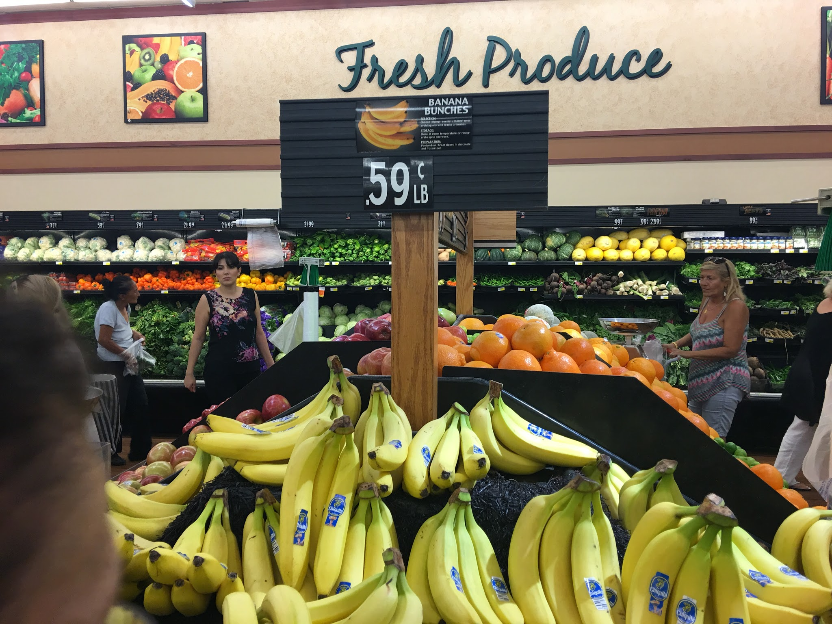

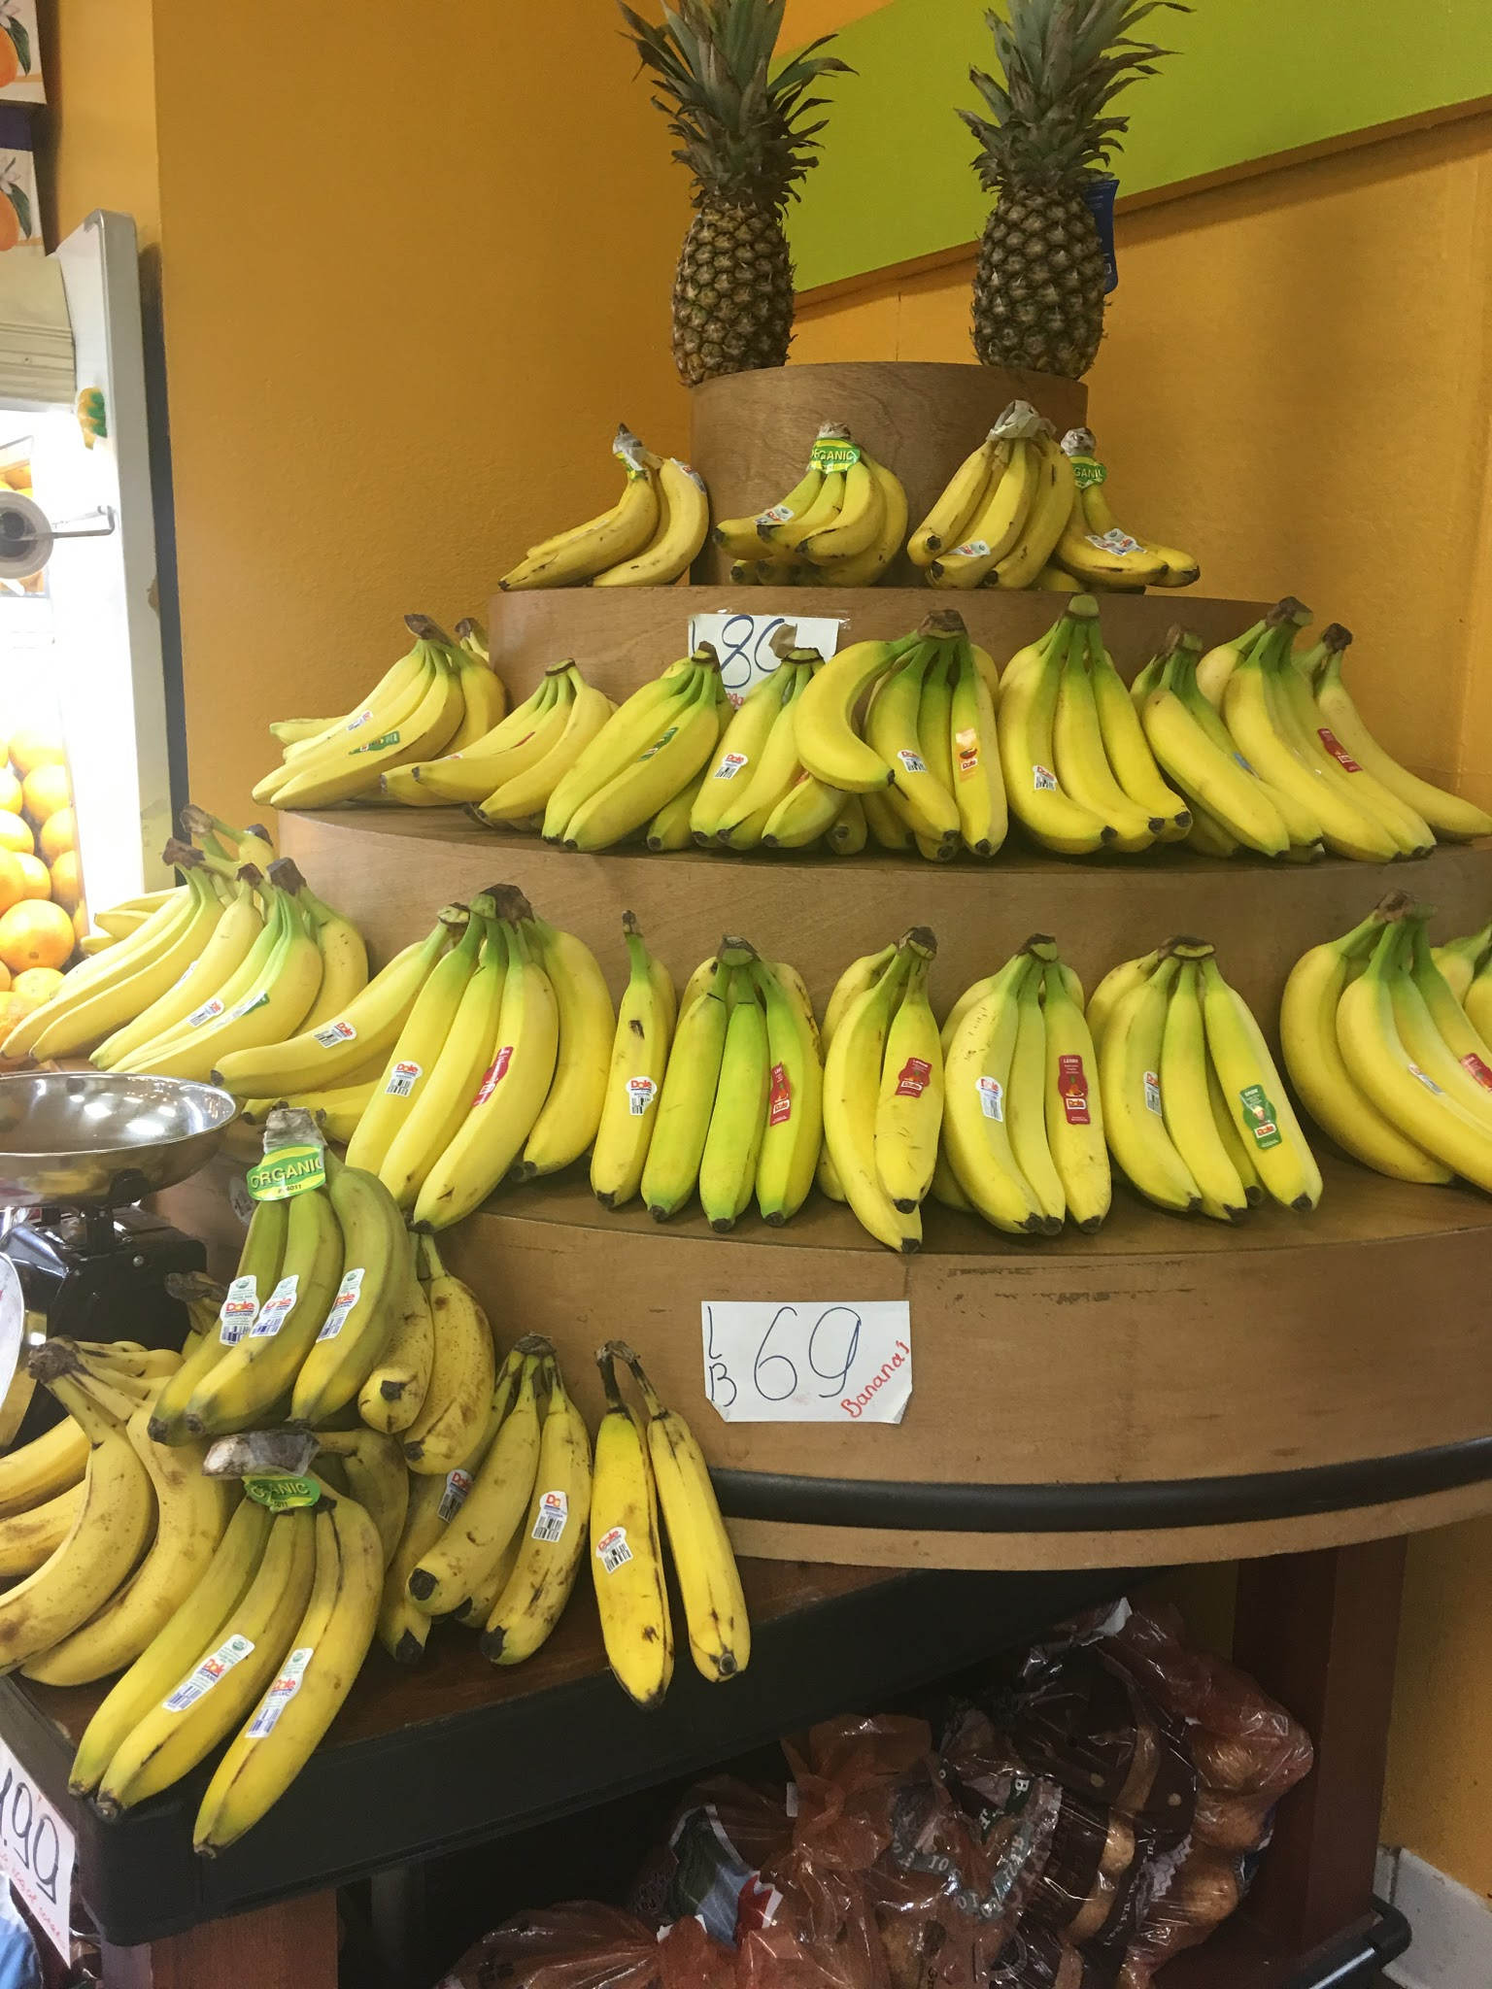
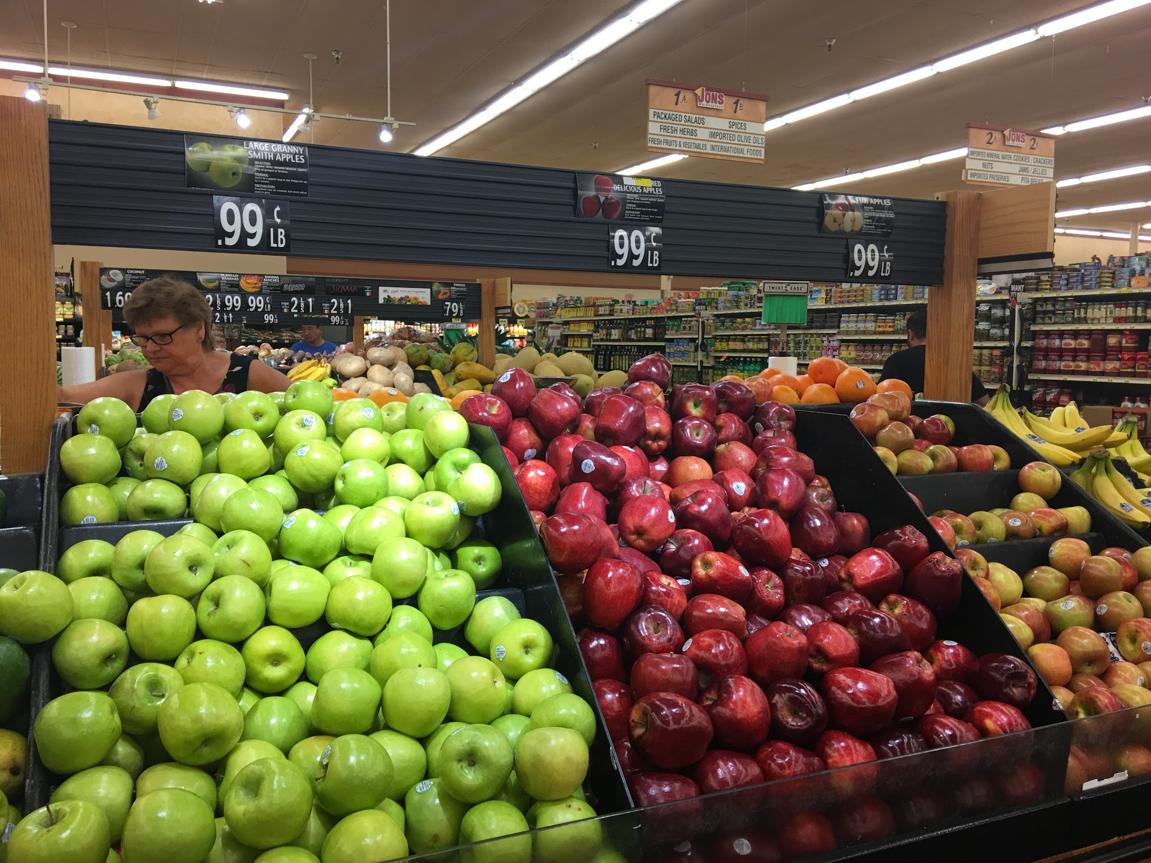
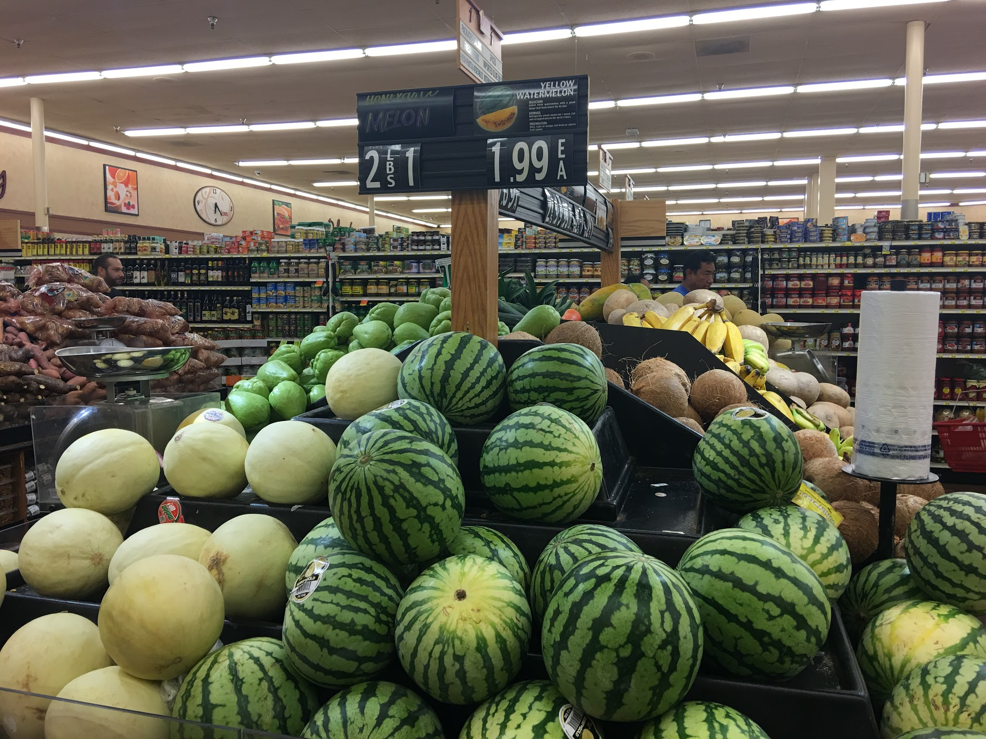

Supermarket
Jons Marketplace
Kozanian’s Ranch Market
Apples:
$0.99/lb vs. $0.99/lb
Bananas:
$0.59/lb vs. $0.69/lb
Watermelons:
$1.99 each vs. $0.99/ 2lb

Slide 25



Supermarket
Jons Marketplace
Kozanian’s Ranch Market
Tomatoes:
$0.89/lb vs. $0.99/lb
Cucumbers:
$0.99/lb vs. $1.19/lb

Slide 26




Baby Items
Jons Marketplace
Kozanian’s Ranch Market
Huggies Diaper (44 count): $12.19
Luvs Diaper (34 count): $6.99
Enfamil: $18.99-$19.99
NO BABY ITEMS FOUND

Slide 27


Jons Marketplace vs. Kozanian’s Ranch Market
Both markets allow everyone including those with disabilities to easily access the store
No folk medicines are sold in both stores
There is a diverse group of people who shop at both stores
Those who shop at these stores seem to be in the middle class.

Slide 28
Homeless Resources in Glendale, CA
Government Agencies
(Department of Social Services, Employment Development Department, Salvation Army, Easter Seals)
Food
(Cal-Fresh- former Food Stamps, Catholic Charities)
Hospitals
(Glendale Adventist Medical Health, Verdugo Hills Hospital, Kaiser Permanente / W. Glenoaks Blvd)
Churches
(First Evangelical Church, Calvary Chapel Glendale)
Red Cross
(American Red Cross)
Domestic Violence
( 274 E california Ave, Glendale, CA)
Alcohol & Drug Services
(Glendale Adventist Medical Center:Employee Assistance Program)
Senior Citizen Services
(Armenian-American Council, Life Services Inc,
Gardens, Home Instead Senior Center, Visiting Angels)
(Homeless Resources for Glendale California, n.d)

Slide 29
Child Care Resources in Glendale, CA
YWCA of Glendale
(Community Programs & Services that gives a Head Start and preschool, extended day care, free cancer screenings, pap smears for mothers)
Children's Information Services
(Provides information and referrals for child care, emergency care)
Center for Community & Family Services
(care routines, nutritious daily meals, formula & diapers, breastfeeding support, hearing & vision screenings, mental wellness, access to community resources, centers for transportation)
Glendale Healthy Kids → Dental Resource
(School site referral program, USC mobile dental clinic services,dental education program)
(City of Glendale Social Services and Resource Guide,n.d)

Slide 30


Power Structure
Who is influential in the community?
Teachers/Doctors/Firefighters
Volunteers
People who raise funds in the community for the community

Slide 31



Power Structure
How they are influential?
Good role models
Values
Integrity
Compassion
Empathy
Identify the needs of
people
Seek out changes to
better society above their
own needs

Slide 32



Power of Structure
What solutions do we recommend?
Education about dangers of smoking
Prevention
Identify potential public health problems/high risk groups.
Smoking
Children
Teens
Elderly

Slide 33

Target Group
Identify potential target groups to teach
Teenagers and Young adults
“Taken on a state-wide basis, California would seem to have the worst drivers overall, placing five cities among the top 25, including Glendale (5), San Francisco (10), Los Angeles (14), Fullerton (16) and Torrence (22)” (Forbes, 2012)
Glendale has the highest car
insurance insurance in California. (KPCC, 2014)
(KPCC, 2014)

Slide 34
References
City of Glendale Social Services and Resource Guide. (n.d). Glendale California. Retrieved from: http://www.glendaleca.gov/home/showdocument?id=7538
Economic Statistics.(n.d). Infoplease. Retrieved from: http://www.infoplease.com/us/census/data/california/glendale/economic.html
Forbes. (2012). Forbes Welcome. Retrieved from http://www.forbes.com/sites/jimgorzelany/2012/08/28/cities-with-the-worst-drivers-2012/#340e1c8e624f
Glendale Chamber of Commerce. (2016). “Welcome to the Glendale Chamber of Commerce.” Glendale Chamber of Commerce. Retrieved from http://www.glendalechamber.com/
Homeless Resources for Glendale California. (n.d). Homelessresourceca. Retrieved from: http://www.homelessresourcesca.org/Cities/GlendaleCaliforniaHomelessResources.html
Lee, W. (n.d.). Report: Glendale has the highest car insurance in California | 89.3 KPCC. Retrieved from http://www.scpr.org/blogs/economy/2014/03/11/16046/report-glendale-has-the-highest-car-insurance-in-c/

Slide 35
References
Public Transportation. Glendale California Mobile. Retrieved from: http://www.glendaleca.gov/government/departments/public-works/public-transportation
Rent trend data Glendale, California. Rent Jungle. Retrieved from: https://www.rentjungle.com/average-rent-in-glendale-ca-rent-trends/

